Slide 1
The Art of Accessible PDFs: From Problem Document to Usable PDF
A practical walkthrough of PDF remediation and when PDFs should (and shouldn’t) be used.
Ministry of Justice Digital
Notes:
Hello everyone and welcome to this session titled elevating accessibility: moving documents from good to excellent.
For anyone using a screen reader, the main content stops when you hear "Presenter chat notes”. Stop here unless you want to read the notes as well as the slide content.​

Slide 2

Hello!
Samantha Merrett
Senior Accessibility Specialist
Ministry of Justice
Notes:
So I wanted to just start by introducing myself, I am a Senior Accessibility Specialist at the MoJ primarily responsible for capability building and training across the organization.
I run monthly training sessions and one-off team sessions to raise awareness and help to build skills across the organization. I also run the MoJ Accessibility Bar offering colleagues a chance to get hands-on experience with various types of assistive technology.
I am a blonde woman in her 20s, I am wearing a pair of glasses and have my hair in a bun today. The picture on the slide is of me hugging my beautiful pet dog Bella a big cuddle and she is a blue Staffordshire bull terrier.
You will learn throughout this presentation that I am a big fan of dogs and have littered different pictures of them throughout this presentation.

Slide 3
Agenda
Why are PDFs so misunderstood?
Should this even be a PDF?
Common PDF accessibility fixes
Top 10 PDF Accessibility Wins
Notes:
Today we are going to cover as much as we can in the time w have together and I would like to leave plenty of time for questions!
We are going to discuss:
Read from the slide

Slide 4
Let’s define PDF
Notes:
Let’s first define what a PDF document actually is.

Slide 5

The definition of a PDF document
PDF stands for Portable Document Format.
It is a universal digital file format developed in 1993. They display documents in a fixed layout, ensuring they look the same across any operating system or device.
Notes:
On this slide, we have our first dog picture a brindle dog looking at the camera with one ear poking up as if he is looking for an answer.
PDF stands for Portable Document format.
It is a universal digital document format that was developed in 1993. It displays documents in a fixed layout ensuring they look the same regardless the device or operating system they might be viewed on.

Slide 6
Why are PDFs so misunderstood?
PDFs can’t be accessible
PDFs never work with screen readers
If it passes Acrobat Checker it is accessible
Converting Word to PDF automatically makes it accessible
Notes:
So why are PDFs so misunderstood?
There are some myths that I often hear in my organization things like
READ from slide
None of these are true and I hope this session today will help you to understand why.

Slide 7
Before we start fixing PDFs…
Notes:
However, before we start fixing PDFs…

Slide 8
Should this even be a PDF?
Use a simple decision tree:
Does it need to be printed?
Is layout preservation critical?
Could this be HTML instead?
Would a Word document meet the same need?
Notes:
Ask yourself, should this even be a PDF?
To help you decide what the right answer might be ask the following questions:
Read from slide

Slide 9
Sometimes… ‘The most accessible PDF is often no PDF at all.’
Notes:
I just want to leave you with this thought before we get practical –
Read from slide.

Slide 10

Important – Adobe Acrobat Pro required!
This is the licenced version of the software.
If you do not have this software, please do not convert documents to PDF.
Notes:
Before we start looking at the accessibly of PDFs in detail it is important to understand some of the basics.

Slide 11

The source document
The best place to start is with your source document.
It is easier to fix accessibility issues at the template level.
You must follow the correct process when converting your document to PDF.
Notes:
As ever, if you have access to the source document this is the best place to start.
On this slide, there is an image of a terrier dog wearing a trench coat, leather gloves and holding a magnifying glass.
It is much easier to fix accessibility issues in the source document than in a PDF.
Most applications provide options for making your source document accessible. The more accessibility work you can do here, the better. For every accessibility issue that remains in the source document, it is likely to be multiplied when converted to PDF.
It is important to follow the correct procedure for converting your document to PDF. This will ensure that accessibility features will be carried through to your PDF. This will make the next steps easier for you.

Slide 12

Do not print to PDF
DO NOT print to PDF – if you do the resulting PDF will not be accessible.
Notes:
If you print to PDF from any application or web page, the resulting PDF will not be tagged and will require full manual tagging to make it accessible
On this slide, there is a picture of a small dog looking shocked holding it’s paws up to its ears and the words ‘Oh no!’ written at the bottom.

Slide 13
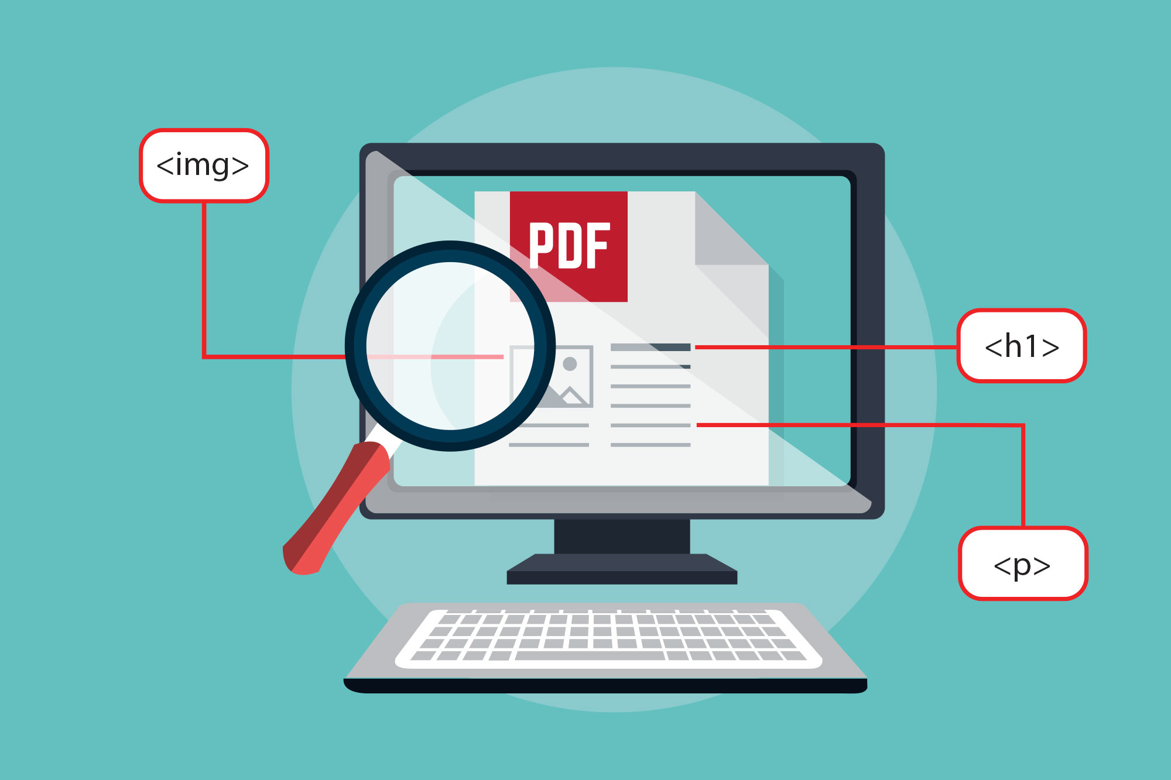
What makes a PDF accessible?
Searchable text
Fonts that allows for character extraction
Document structure tags
Proper reading order
Alternative text
Notes:
So what are the characteristics of an accessible PDF?
They should have searchable and selectable text.
Accessible fonts should have been used so that the text can be read and understood by humans and technology alike.
The PDF should have tags so that it can be read and understood by assistive technology.
The reading order should be clear and logical.
All image content should have alternative text just like in any other application.

Slide 14
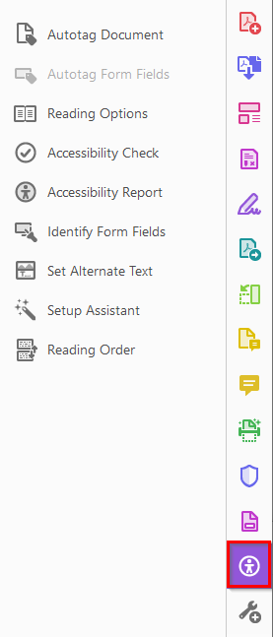
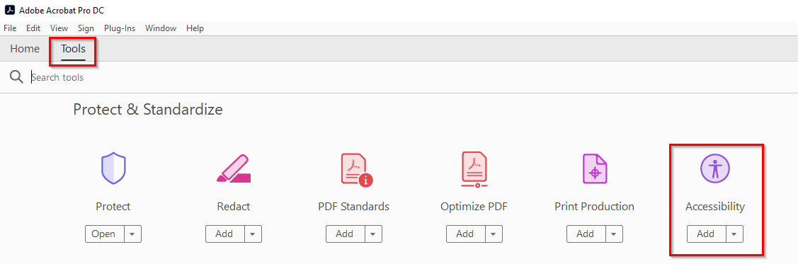
Setting up Acrobat for accessibility work 1
From the Tools link in the top menu add the Accessibility tools
The Accessibility Tools can then be selected from the Tools menu to the right of the screen
Notes:
To start off … in order to set up acrobat for accessibility work … you need to have certain sections of the interface visible to you.
First thing you need is the accessibility tools on the right-hand side of your screen. Either from Tools at top of screen, or More Tools in the tools pane.

Slide 15

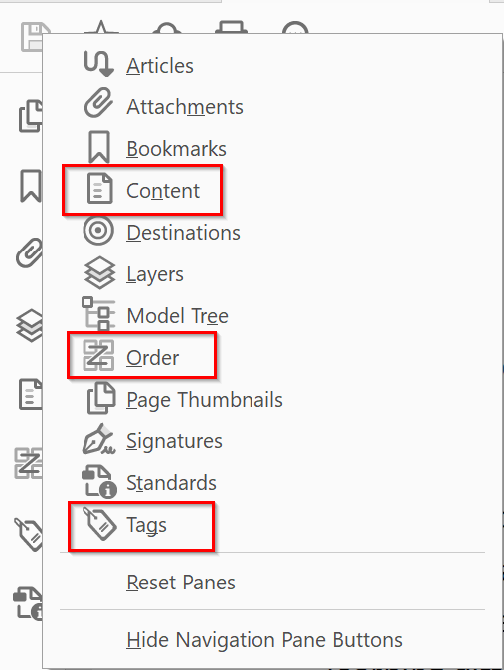
Setting up Acrobat for accessibility work 2
Add the Content, Order and Tags panes to the navigation pane on the left of the screen by right-clicking on the navigation pane and selecting them or via View > Show/Hide > Navigation Panes
Notes:
And the Content, Order and Tags panes on the left-hand side of your screen.

Slide 16
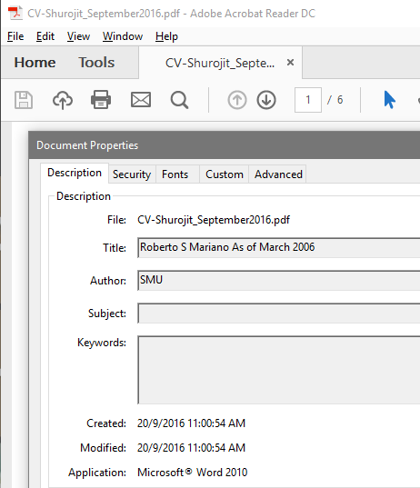
Descriptive file name
It is the first encounter
Keep it unique and descriptive
Change the document title using the document properties menu.
Notes:
When accessing a document, the first thing encountered is the file name.
A unique, descriptive file name helps individuals understand what the document topic is. This is no different than if you were using a word, powerpoint presentation or excel document either.
Assistive technology will read the file name when the document is accessed. Keep the file name and the document title similar and related but not the same. If the file name and the title are the same, it may lead to confusion for the user as they may think they did not open the file.

Slide 17
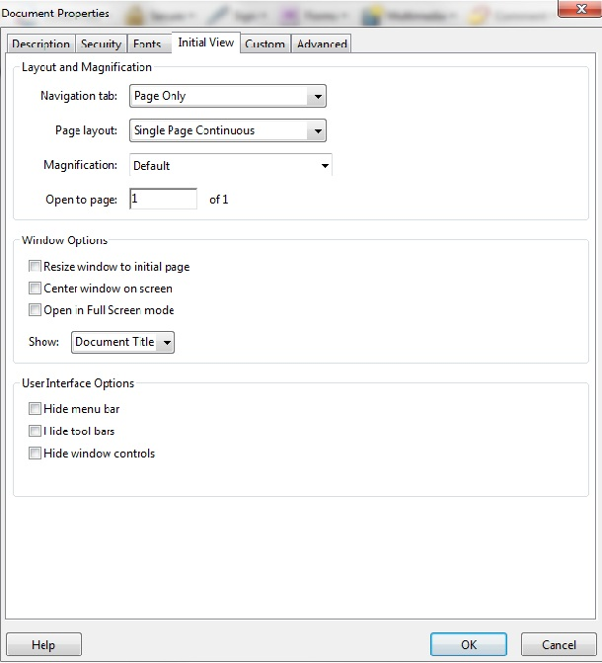
Setting the document title
Set document title
Check the author box too!
Then under the ‘Initial view’ tab choose to show Document title.
Notes:
The intent of this technique is to show how a descriptive title for a PDF document can be specified for assistive technology by using the /Title entry in the document information.
Document titles identify the current location without requiring users to read or interpret page content. Assistive Tech make the title of the page easily available to the user for identifying the page. For instance, a user agent may display the page title in the window title bar or as the name of the tab containing the page.

Slide 18
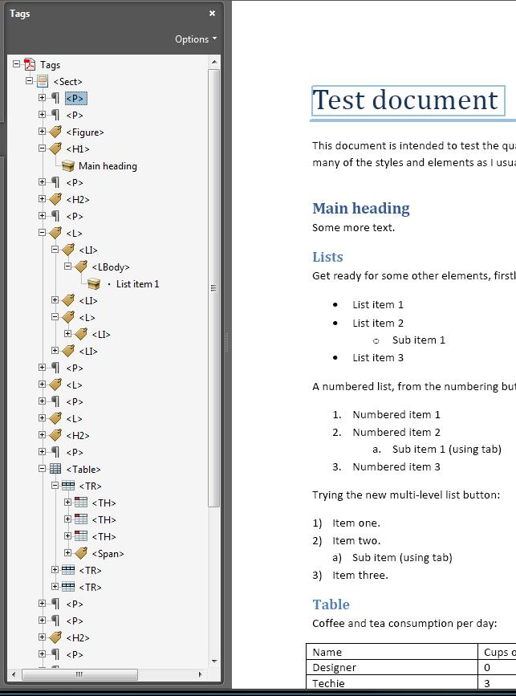
What are tags?
Tags make it possible to identify content as headings, lists, images and tables etc.
Without tags it is impossible to use accessibility features.
Notes:
Web developers will already be familiar with tags, as they form the basis of HTML code. A tag tells the browser or screen reader what type of content something is. Most text is tagged as paragraphs with a <p> tag. The main heading on a page is tagged with a <h1> tag, followed by <h2> tags, and so on.
In a PDF, tags perform a similar role, except that they don't affect the actual content on a page. On a webpage, if tagged content is missing, it will not display, whereas in a PDF it will, but screen readers will not be able to access it. Tags are therefore critical to PDF accessibility.

Slide 19
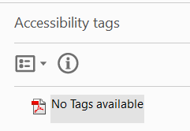
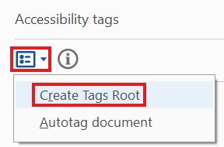
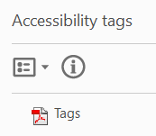
Create a tags root
Open the tags pane.
Select Options dropdown.
Select Create Tags Root.
Notes:
The first thing you need to do before you can create any tags, is to create a tags root. I’ve got three small screenshots on this slide. The first shows the tags pane with the message no tags available. That means you need to create a tags root. The second shows where you can do this. In the tags pane, select the Options dropdown, and the select create tags root. The third screenshot shows the outcome of that where the no tags available has now changed to Tags.

Slide 20
Types of tag
<P> paragraph – normal text
<H1> heading level 1 – main title of document
<H2> heading level 2 – main headings in document
<Figure> image – needs alt text
<L> list – an ordered or unordered list
<LI> list item – must be embedded within the <L> tag
<Link> hyperlink – usually embedded within a <P> tag
Notes:
There are many different types of tag. Here are the main ones. Read through the slide

Slide 21
Auto Tagging
Acrobat assesses its layout, structure and content to determine whether or not it can be read.
It WILL NOT produce an instantly accessible PDF on its own.
It is a one and done solution.
Notes:
It’s tempting to just click Adobe’s free “auto-tagging” feature to shortcut the task of making PDFs accessible for people with disabilities.
As the grumpy looking beagle wearing glasses sitting in front of a laptop suggest auto-tagging is a bad idea.
But auto-tagging often won’t produce an instantly accessible PDF on its own. You’ll need to manually verify the document is tagged correctly, no matter what kind of automation you employ.
Adobe Acrobat wasn’t designed as an accessibility tool. It is a publishing tool, like Microsoft Word or Google Docs (both of which actually have better native accessibility tools built-in). Using the auto-tag feature isn’t the one-click accessibility solution some may think it is. Auto-tagging a document can be a useful starting point for remediation, but it is not meant to be a one-and-done solution.
Auto-tagging results in errors and it can be a liability.

Slide 22
Let’s have a look together…
Notes:
Let’s get even more practical now.

Slide 23
Heading tags
<H1> Document title
<H2> Main headings
<H3> Subheadings
<H4> Sub-subheadings
Notes:
Headings are very important for screen reader users. The heading text needs to be meaningful and tell the user what the content will be about.
The levels of the headings are important. Headings should be nested correctly, and you shouldn’t skip heading levels. A document should normally have one Heading level 1 and that should be the main title of the document. Any main headings within the document should be heading level 2. Any subheadings within a H2, should be heading level 3. Sub-subheadings within a H3 would be heading level 4 and so on. Technically you can go up to H6, but in reality, these are very rarely needed.

Slide 24
Logical reading order
Reading order highlights all content with a pink outline box.
Anything not in a box has not been tagged.
You can drag and drop content into the right order of the tags tree.
Notes:
Logical reading order in a PDF document refers to the sequence in which the content is read and interpreted by assistive technologies, such as screen readers. Ensuring a logical reading order is essential for making PDFs accessible, particularly for users who rely on these technologies to understand the document.
If the reading order of a PDF is not logical, screen readers may misinterpret the content, read it out of order, or fail to convey important information accurately, which can make the document unusable for people with visual impairments or cognitive disabilities.
Reading order will follow the visual layout and should follow the visual layout of the document.

Slide 25
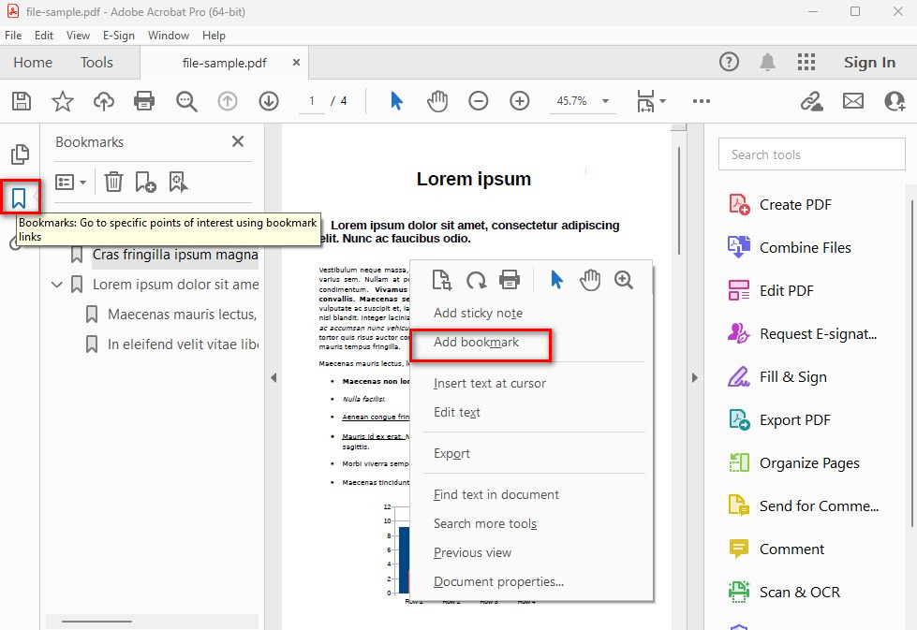
Bookmarks
You can add bookmarks based on document structure or navigate to the appropriate page and add a bookmark directly.
Ensure your bookmarks have descriptive names.
Notes:
Bookmarks in a PDF document are a feature that allows for easy navigation to specific sections, pages, or content within the document. Think of bookmarks as a table of contents or a navigation menu that helps readers quickly jump to areas of interest without having to scroll or search manually. Bookmarks are especially useful in long or complex PDF documents, improving the overall accessibility and user experience.
Screen Reader Support: For users who rely on screen readers, bookmarks help in navigating a PDF quickly, as they can use the bookmarks panel to jump directly to relevant sections of the document. This makes the PDF more accessible to people with visual impairments.
In Adobe Acrobat Pro, you can create bookmarks by navigating to the Bookmark Panel and selecting text or a page you want to link to. You can then right-click and select Add Bookmark. You can also organize bookmarks into a hierarchical structure by nesting them under other bookmarks.
Bookmarks can be linked to specific pages, headings, or even a position on a page, allowing for detailed control over navigation.

Slide 26
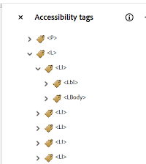
List tags
Create a list container <L>
Add a list item <LI> inside the list
For each item add <Lbl> for the bullet or number
Text uses a <Lbody>
Notes:
“A list is just a container with items inside it — and each item has two parts: the bullet and the text.
Then map that visually:
List (L) → the whole list
List item (LI) → each line
Label (Lbl) → the bullet or number
Body (LBody) → the text

Slide 27
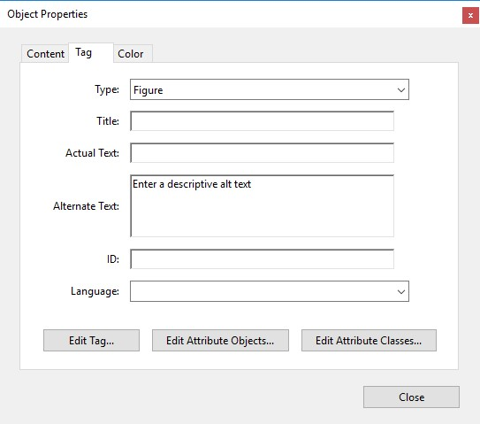
Adding alt text to images
There are various ways to add alternative text for images.
Right select on the image tag, select ’Properties’ and then under the ‘tag’ tab find the alternate text field.
Or you can fix it directly from the accessibility checker list or by using the ‘Set alternative text’ tool.
Notes:
If you use the set alternative text field you can set the description for each image in sequential order, you will also see the option to set images as decorative.
If your image has not been tagged already, you need to go into the Reading Order pane and identify the image as a figure first. Then it should appear in your tags list. However, where it actually appears is anyone's guess! You might have to search for it and then move it to the correct place in the tags list.

Slide 28
Artifacts
Artifact content so it is ignored.
Select the empty <p> tags
Artifact page numbers, headers and footers as appropriate
Use the reading order tool to background/artifact content that you do not want to appear in the reading order.
Notes:
Marking elements of the document as artifacts, means those elements will be ignored by screen readers and other assistive technologies. The purpose of doing this is to exclude non-essential or decorative content that doesn’t contribute to the meaningful structure or understanding of the document.
When creating accessible PDFs, artifacting helps improve the reading experience for users who rely on assistive technologies. It ensures that only relevant and meaningful content is announced by screen readers and other devices, while non-informative elements like purely decorative images or formatting elements are ignored.

Slide 29
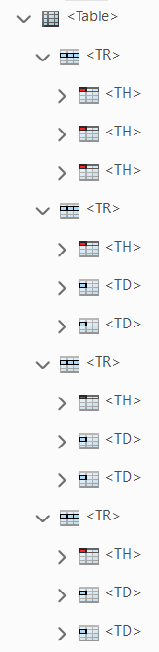
Table tagging
<Table> all other table tags must be nested within
<TR> table row – must be inside <Table>
<TH> header cell – must be inside <TR>
<TD> data cell – must be inside <TR>
Notes:
Table tags are a bit more complicated and really resemble HTML code.
There are 4 different tags that are essential for a table. Begin with a table tag. Inside that, there should be TR tags for each row of the table. Inside each TR tag, there should be either TH tags or TD tags or both. TH tags are for header cells. These tell the user what all the content in that row or column is about. When a screen reader navigates a table, these header cells are read out when moving to a different row or column.
Table data cells are for the main content in the table.

Slide 30
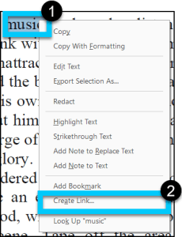
Adding and tagging links
Select the text and right-click and ‘Create link’.
Specify link text destination – this adds object reference and formats the link correctly.
Assign a different colour and underline.
Notes:
Multiline links often present a unique challenge. In these situations, it can be beneficial to delete the links and retag the entire text at once. This technique maintains the link’s accessibility and ensures it has a single link object reference.

Slide 31
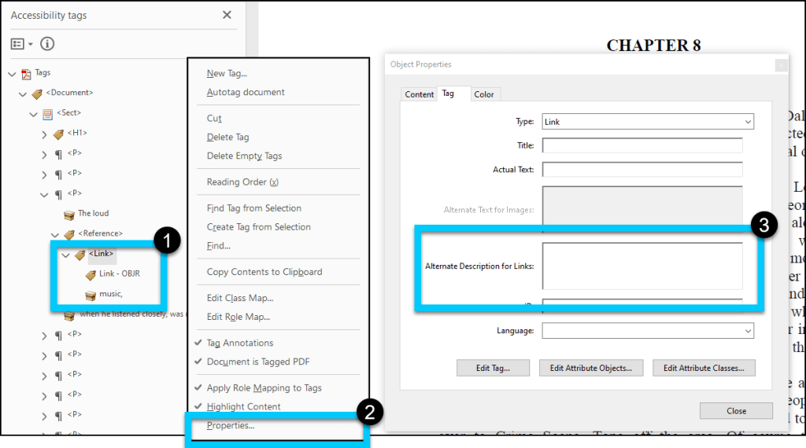
Alternate text for links
Find the link tag in the tags panel
Right-click and select properties
Update the alternate text and include hyperlink again.
Notes:
A critical component of making PDF links accessible is the addition of alternate text. Providing additional context for the link, alternate text is a requirement for certain accessibility standards.
Screen readers can read visible link text, but replacing the screen text with meaningful alternate text for links in a PDF document can make links more accessible.
When the Link tag has an /Alt entry, screen readers ignore the value of any visible text objects in the Link tag and use the /Alt entry value for the link text.

Slide 32
Checking PDF accessibility
Notes:
Now we are going to focus on checking the accessibility of a PDF document.

Slide 33

Inspecting the tags tree
Walk the tag tree – open the ‘Tags’ pane
Place focus at the top of the tree
Use the arrow keys to inspect the tags and make sure the structure is correct
Notes:
Inspecting the tags tree
On this slide, we have a small dog wearing glasses and a hoodie looking as if he is typing on a laptop.
Read from slide.

Slide 34
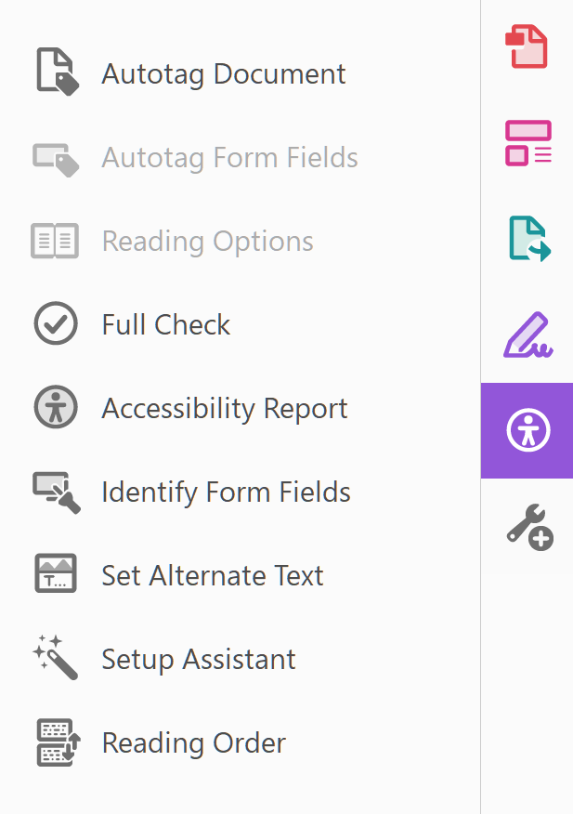
Using the accessibility checker
Helps to identify potential issues in PDFs and provides guidance on how to fix them
You can fix some issues straight from the error list by right-clicking the issue and selecting ‘Fix’.
Make sure all 32 categories are selected for the check.
Notes:
The built-in Accessibility Checker in Adobe Acrobat helps identify potential accessibility issues in PDFs and provides guidance on how to fix them.
It evaluates the document against accessibility standards, such as making sure the document has tags with proper semantic structure, figures have alt text, metadata such as document title and language assignment are included, as well as other accessibility checkpoints.

Slide 35
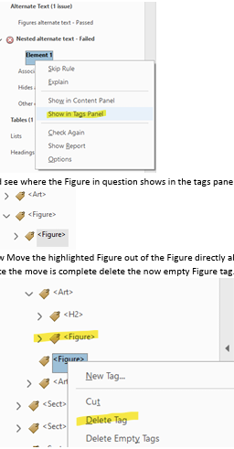
Understanding the errors: Nested elements alternate text failed
First find where the element is in the tags panel.
There is a figure tag within another figure tag.
Move the child figure tag out of the order
Once moved, delete the tag.
Notes:
Read from slide.

Slide 36

Limitations of the checker
Does not fully adhere to accessibility standards
Inaccurate alt text checking
Overlooks hyperlink issues
Inconsistent reading order evaluation
Notes:
What it checks: Adobe Acrobat Pro's Accessibility Checker can verify compliance with basic accessibility requirements, including headings, alternative text for images, document structure, and the presence of tags. It also checks for some PDF/UA (Universal Accessibility) standards.
Limitation: It primarily focuses on basic issues. It doesn’t always catch more nuanced accessibility problems, such as complex tables, color contrast issues, or detailed text-to-speech compatibility. It might miss some issues that are more advanced and require manual checks or the use of additional tools.
Limitation: The Accessibility Checker does not assess the quality of the content itself. For example, it may flag that an image has alt text, but it cannot tell if the alt text is descriptive enough or if it properly conveys the meaning of the image. It's also unable to check for appropriate semantic meaning in complex content, such as charts or graphs.

Slide 37
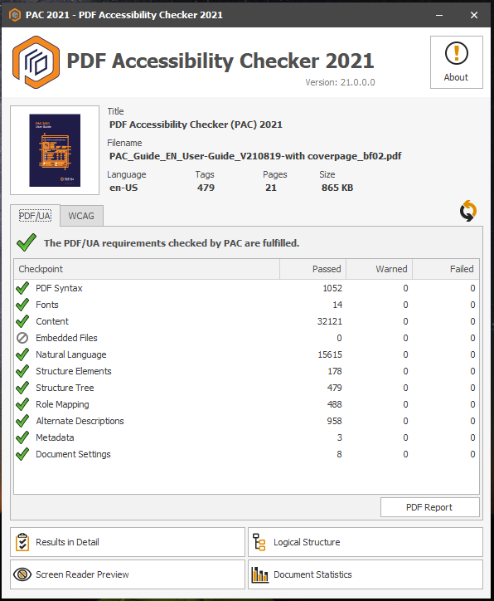
Go one step further, use PAC
Free tool for Windows users
You can test for PDF U/A and WCAG compliance
Notes:
PAC (PDF Accessibility Checker) is a free tool for Windows users designed to test PDF/UA (Universal Accessibility) compliance in PDF documents.
It is more specialized than Adobe Acrobat’s built-in accessibility checker and provides a detailed report on accessibility issues.

Slide 38

Top tips
Save you work frequently – Acrobat is prone to crashing
Acrobat’s undo function is very limited so copy your work frequently
If your original document has visual accessibility errors – you cannot amend these in Acrobat.
Notes:
Here are just some top tips for you – on this slide we have a dog with a headset and microphone sitting in front of a laptop.
Save your work frequently, as Acrobat is prone to crashing.
Frequently copy your document and save it as a back-up – Acrobat’s Undo function is very limited.
The Revert option in the File menu can be useful to return to the last saved version.
If your original document has visual accessibility errors, you cannot amend these in Acrobat.

Slide 39
Final steps…
Check the reading order pane – delete empty objects
Rerun the accessibility check once last time
Check with a screen reader.
Notes:
Read from slide.

Slide 40
International Document Accessibility Group (IDA)
Join the International Document Accessibility group to learn about document best practice from various organisations.
Join the LinkedIn Group to find out more information – International Document Accessibility Group.
Notes:
One last thought to share in case some of our on this call are interested. Myself and a colleague at the Department for Work and Pensions in the UK have recently set up an International Document Accessibility Group (IDA) for short. The aim of the group is bring together professionals from both the public and private sector around the world to talk about document accessibility. We are still getting the group off the ground but feel free to join our LinkedIn community and we will be arranging a group call very soon.

Slide 41
Thank you!

Slide 42
Questions?
Notes:
Do you have any questions about what we covered today?
Thank you very much for your time!

