Slide 1

Hiring for Inclusion: Building an Accessibility-Centric Workforce

Slide 2


Introductions
Kate O’Connor, CPACC
VP + Practice Leader
Onward Accessibility
Catherine Sherry, CPACC
Director of Staffing
Onward Accessibility

Slide 3

About Us
Division of Onward Search, an award-winning talent and solutions provider for 15+ years
IAAP-Certified team of strategic advisors and talent acquisition specialists
Network of 5,000+ a11y & XD professionals, including People with Disabilities (PwDs)
3,000+ satisfied clients, including Fortune 100 companies across every major industry
Veteran-led company centered on entrepreneurism, service, integrity and DE&I

Slide 4

Discussion Agenda
The Importance of inclusion in the workplace
Laws + Regulations
Barriers
Accommodation Requests
Disability Inclusion in the Hiring Process
Resources
Question & Answer Session

Slide 5

Importance of Inclusion in the Workplace
Drives Innovation
with diverse perspectives
Elevates Retention
with employees who are proud to be part of inclusive culture
People with Disabilities (PwDs) are the worlds largest minority
Boosts Performance
by tapping into talent and skills

Slide 6

Laws and Regulations
Americans with Disabilities Act (ADA)
European Accessibility Act (EAA)
State + Local laws
Equal Employment Opportunity Commission (EEOC)

Slide 7


Common Barriers
Websites
Job boards
Applications
Complex language / process
Awareness

Slide 8
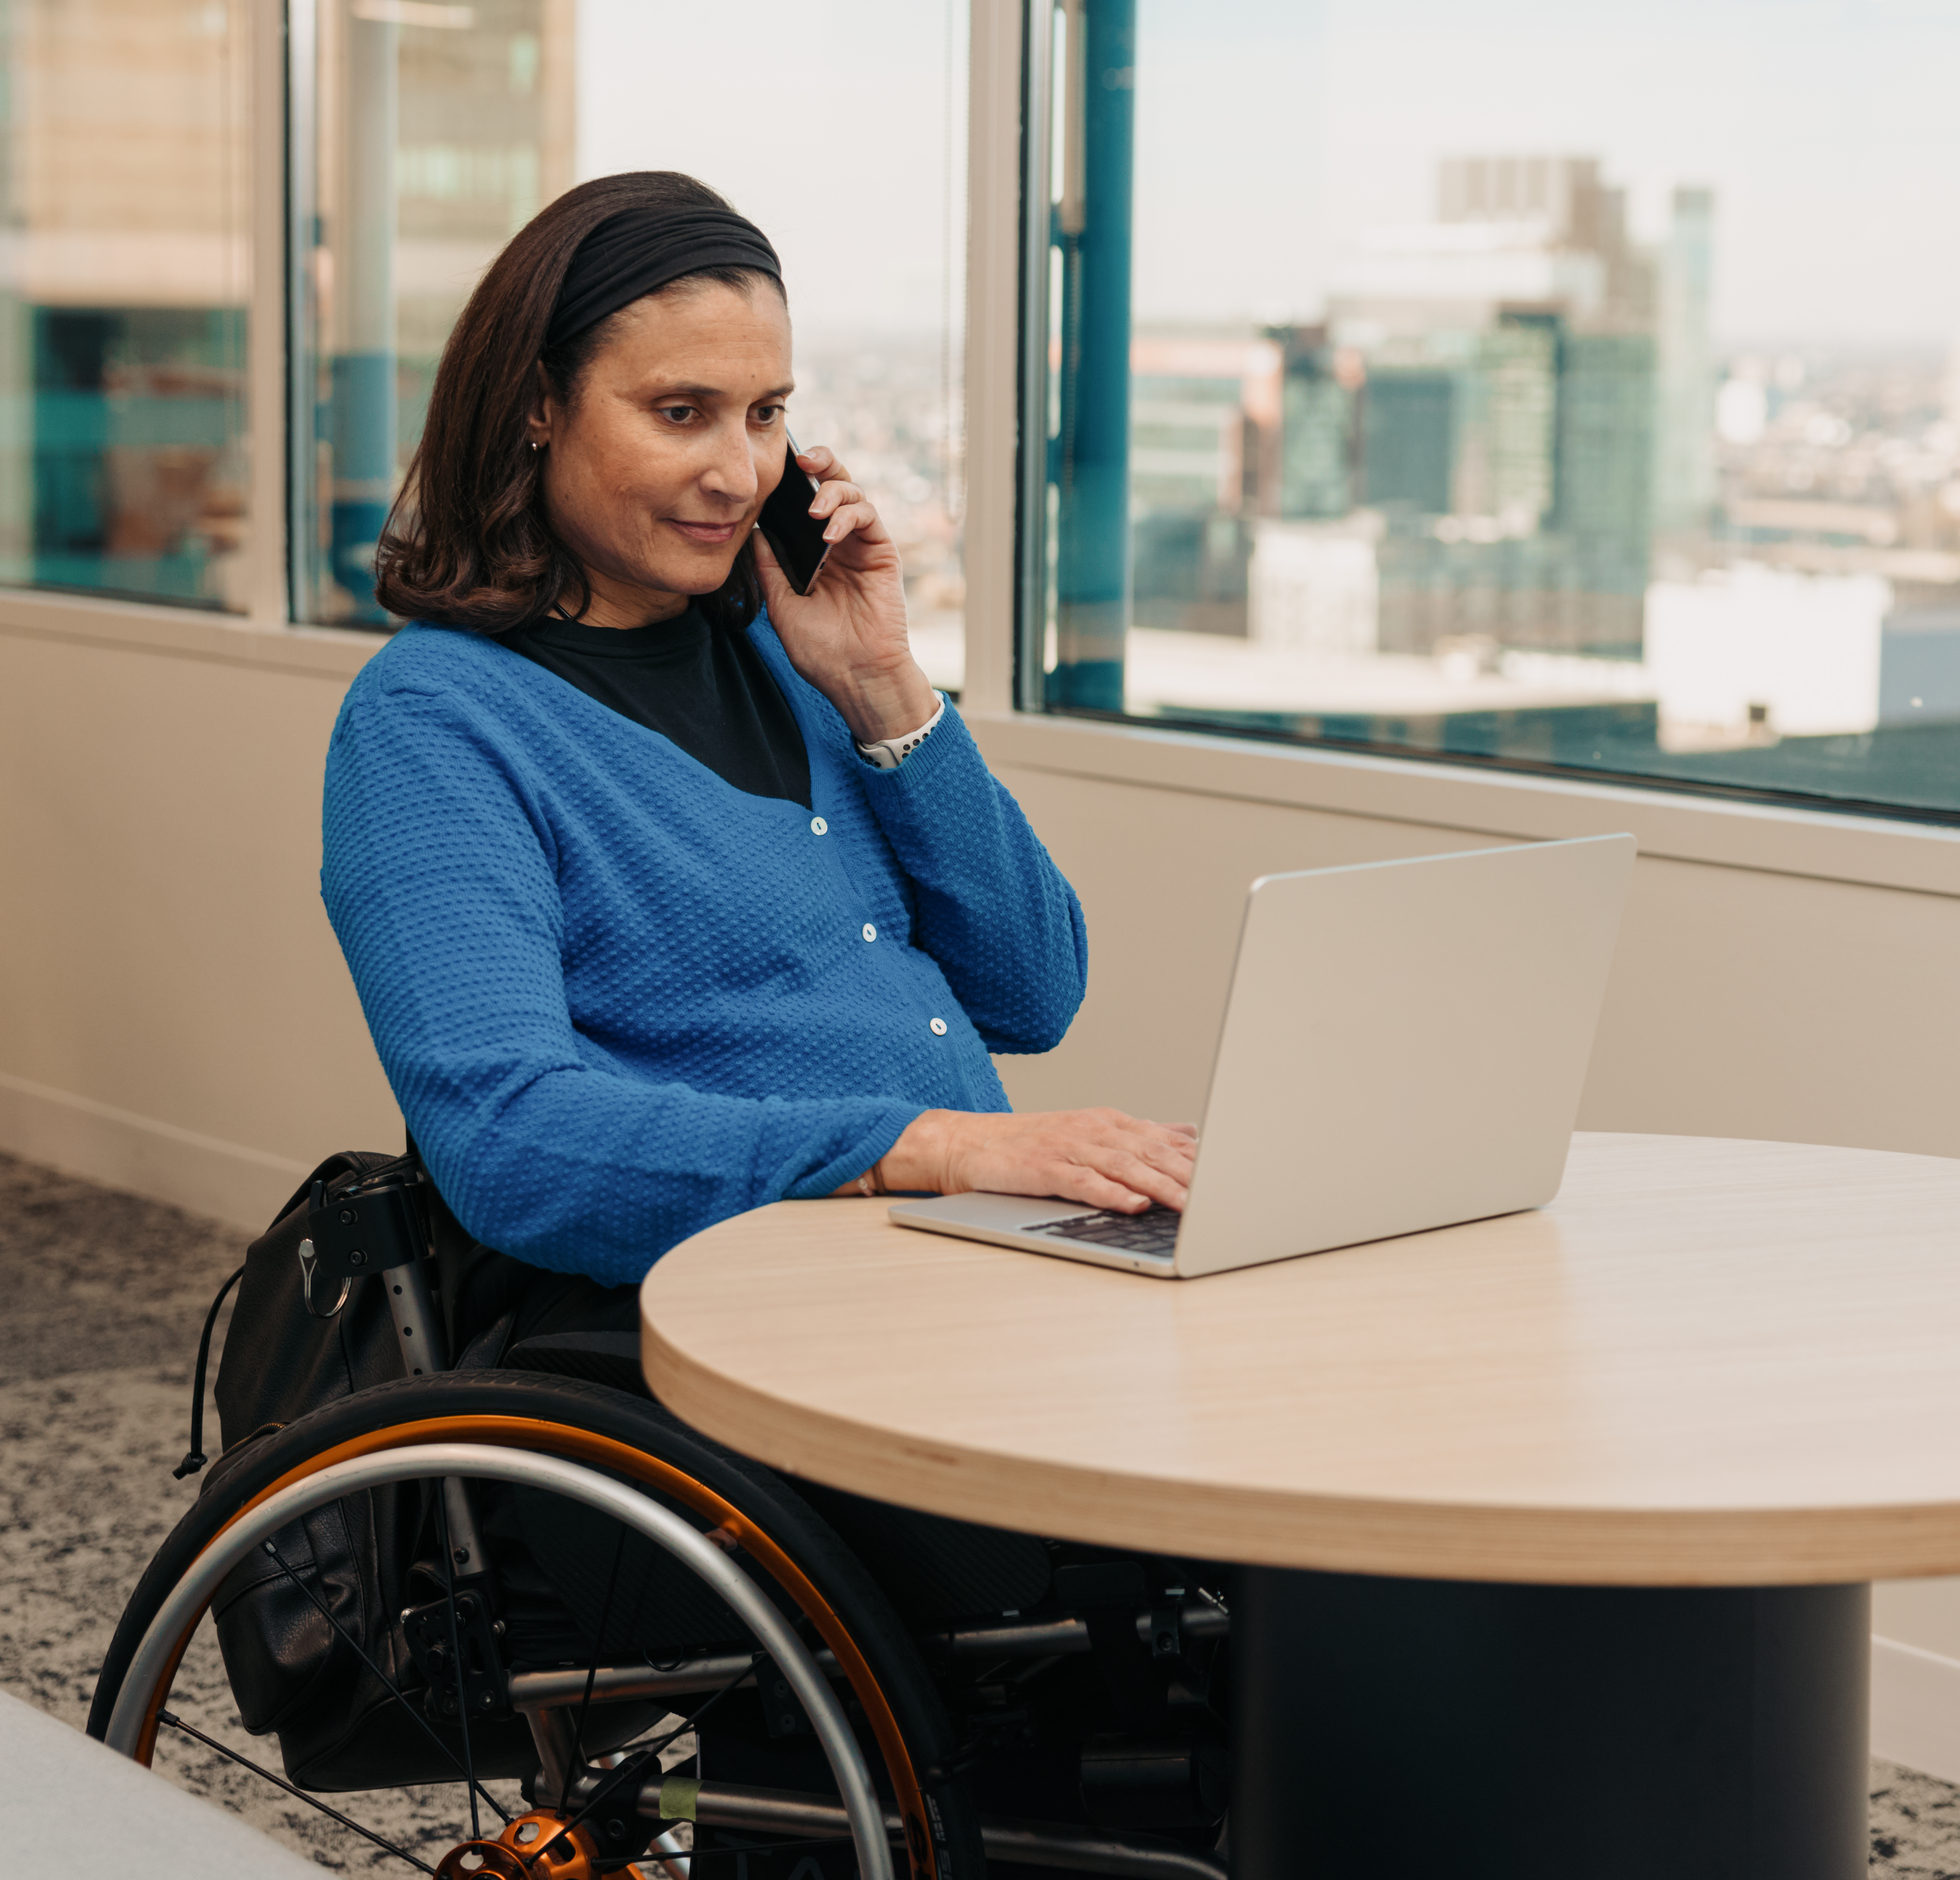
Accommodation Requests
Physical Accessibility
Including adjustments to the workspace
Flexibility
Time off, adjusted hours, interview options, extended time on tasks
Assistive Technology
Screen readers, software, peripherals, captions

Slide 9
Disability Inclusion in the Hiring Process
Recruit
Interview
Offer
Onboard
Thrive
Prioritize recruitment process accessibility
Communicate commitment to inclusion
Use plain language in communications
Source candidates from inclusive job sites
Train teams to recruit without bias
Represent inclusive clients & diverse talent
Inquire about accommodation needs
Adjust hiring processes as requested
Offer multiple interviewing options
Build accessible experiences with PwDs

Slide 10

Best Practices
Check your bias
Institute a formal accommodations process
Train your staff on disability inclusion
Implement Employee Resource Groups (ERGs)
Assess and evaluate your processes and practices

Slide 11
Resources
DisabilityIN – a nonprofit dedicated to business disability inclusion. Their website includes toolkits and resources for inclusive workplaces.
Equal Employment Opportunity Commission (EEOC) Resources – Again, the commission (enforcing US laws about disability inclusion in hiring) has some informative resources on their website.
ADA National Network – offers information and technical assistance on the ADA in particular.
Center for Disability Rights – advocates for equal rights and inclusion for people with disabilities (and provides services like sign language interpreting).
Job Accommodation Network (JAN) – provides guidance on workplace accommodations and disability employment issues.

Slide 12
Q+A
Thank you!

