Slide 1
THE LAW OF ACCESSIBLE WEBSITES AND APPS

Slide 2
You can believe me, I own a suit
Richard M. Hunt
rhunt@hunthuey.com
214-641-9182
hunthuey.com
accessdefense.com
Notes:
Thanks etc.

Slide 3
The usual (but important) disclaimer.
Nothing in this webinar creates an attorney-client relationship between the presenters and viewers, and none of my comments should be considered legal advice concerning specific matters or issues.
Notes:
My partner Jeanne Huey is an expert in legal ethics, so I like to be careful about these ethical issues. Please do not bring up specific lawsuits or demands and please do not mention names of companies in your questions. If you need that kind of specific information, feel free to email or call me and I’ll discuss what I can do for you in a particular matter.
SLIDE

Slide 4
Our Agenda
Bad news and good news about website accessibility law.
What does “accessible” mean for websites and apps?
What about software solutions?
Litigation, then now and in the future.
Notes:
This webinar may be slightly different than those you’ve heard from experts in accessibility who are not lawyers. As we go along you will see that I am going to emphasize uncertainty in the law and even in what WCAG requires, and then talk about dealing with that uncertainty. In short, there won’t be a lot of clear statements that the law requires this or the law requires that, but there will be some pretty clear statements about what you can and should do in the face of uncertainty.
But let’s start with the uncertainty we’ll be talking about.
SLIDE

Slide 5
Bad news and good news
Notes:
The classic joke starts with the good news and ends with the bad news, but that’s only funny in a depressing way. I’m going to turn it around; first the bad news, then the good news.
SLIDE

Slide 6
Bad news – there are a lot of laws
Section 508 of the Rehabilitation Act
Air Carrier Access Act (“ACAA”)
Congressional Accountability Act
The Americans with Disabilities Act (“ADA”)
Fifty state laws similar to the ADA
Numerous city and other local laws governing accessibility.
Notes:
And this is not even all the federal laws and regulations. Every federal agency has its own regulations implementing Section 508, and the Department of Defense has its own standards.
And every state and many municipalities have their own accessibility laws as well, so there is a lot.
SLIDE

Slide 7
Good news -
The ADA covers almost all private business websites and apps, so you probably don’t need to know the others.
Notes:
There are a few exceptions, but that leads us to the next good news / bad news matter.

Slide 8
Bad News – for privately owned websites there is no legal accessibility standard.
The ADA never mentions the internet or apps.
ADA Title III covers private businesses as they interact with the public – but there are no regulations for Title III.
ADA Title I of the ADA covers private businesses as they interact with their employees – but we have no regulations for Title I.
“Accessible” means whatever a federal judge thinks it means and there are more than 500 of them.
Notes:
In theory, at least, to answer the question “does this business or website meet its accessibility standards?” you would need a lawsuit where a federal judge would decide the question. Short of that we know what the Department of Justice and different private plaintiffs think, but the law is what federal judges, and ultimately the supreme court.
There are DOJ regulations pending for Title III business – which is almost all private businesses – but the previous Trump administration killed the last set of regulations before they could be adopted and will almost certainly do the same with these regulations.
SLIDE

Slide 9
Good news
Everybody seems to be on board with conformance to WCAG 2.x at success level AA as the definition of accessibility for websites and apps.
Notes:
DOJ believes that conforming to WCAG 2.x AA defines accessibility and has been using it in lawsuits and settlements since 2010.
DOJ did pass regulations for city and other local governments adopted WCAG 2.1 AA as the standard for their websites.
Section 508 regulations for federal government agencies uses WCAG 2.0 AA as the accessibility standard for government agencies and government contractors.
The Department of Transportation has adopted WCAG 2.0 AA as the accessibility standard for airlines
Many Courts have found that conforming to a version of WCAG 2.x AA satisfies the requirements of the ADA.

Slide 10
Bad News
No one knows for certain whether Title III of the ADA covers internet or app only businesses.
Notes:
Title III of the ADA says that it covers all ”public accommodations.” Some federal courts of appeal, like the 9th Circuit, say that it only covers businesses with a physical facility open to the public like a shopping center or restaurant. These courts say website must be accessible because it is a service of the physical store that provides a unique way to buy goods and services – but that leaves it uncertain whether every website is covered. What if the store’s website only has hours of operation and a phone number, both of which are available many other places?
Other federal courts of appeal say that internet only and app only businesses are public accommodations covered by Title Iii even if there is no physical store.
And more than half the federal courts of appeal have never answered the question. The Supreme Court had the chance to decide a few years ago and decided not to.
SLIDE

Slide 11
Good news
It doesn’t matter. Whether a website is associated with a physical store or an internet only business it can be accessed anywhere in the United States, and that means it can be accessed in a court that believes it is a public accommodation. As a practical matter you must assume that the website must be accessible.

Slide 12
Let’s review:
There are four federal laws and dozens of state laws that require websites and apps to be accessible.
It is not clear whether any of these laws apply to the website of a private business.
It is not clear what “accessible” means for private business websites.
But it really doesn’t matter – there is a judge somewhere who thinks your website or app should conform to WCAG 2.x AA.
Notes:
Now I’m going to venture out of the law and into what accessibility means in practice for a website. This is dangerous territory for a person with no disability, but I’ll be approaching it based on what I have learned from consultants and discuss accessibility with individuals who are disabled, so I’m not completely ignorant.
SLIDE

Slide 13
What does “accessible” mean for a website or app
Notes:
This probably seems like a funny question, since I just told you that conforming to WCAG 2.x AA is pretty likely to be what the law requires, but there is more to the question than that, and it is worth thinking about.
SLIDE

Slide 14
Two ways to look at website accessibility
Technical standards – Web Content Accessibility Guidelines 2.x success level AA.
or
“The full and equal enjoyment of the goods, services, facilities, privileges [and] advantages” of a website.
Notes:
Title III of the ADA has no regulations that define accessibility and never even mentions the internet.
One way to define it is purely technical – WCAG 2.x AA
Another way is to look at the underlying principle behind accessibility laws; that is, “the full and equal enjoyment of the goods, services, facilities, privileges, and advantages of a website.
Keep these options in mind as we discuss what it means for a website or app to be accessible.
SLIDE

Slide 15
How do disabled people use the web?
Assistive technology – for example:
Screen reader software
Voice input software
Mouse alternatives that interpret gestures.
Technologies incorporated in the web page such as captioning for audio content.
Notes:
Our starting point for understanding accessibility under a non-technical definition has to be how disabled people use the web. I have, somewhere in my notes from attending an accessibility conference, a long list of assistive technologies – these are just a few. BUT
Well over 90% of the problems that lead to litigation concern screen reader software used by those who are blind or have low vision.
With this group it may be a little elementary, but I think it is helpful to remember what kinds of problems a person using screen reader software might encounter with a poorly designed website.
SLIDE

Slide 16
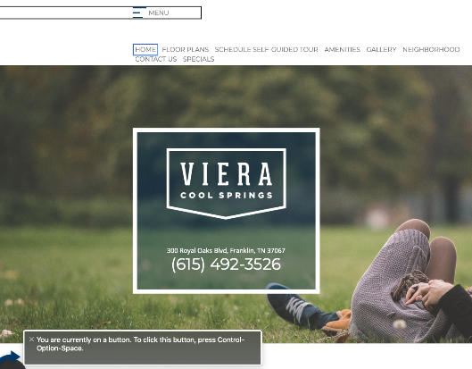
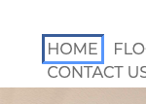
Visual experience vs. screen reader experience
“visted link HOMEPAGE HOME menu navigation. You are currently on a button. To click this button, press Control Option Space”
Notes:
Let’s compare the experience of an ordinary sighted user that can use a mouse with a blind user that relies on a screen reader and keyboard to navigate.
These screen shots were made using Apple’s Voice Over screen reader, but you’ll get very similar results with JAWS, the most popular Windows based screen reader.
So here we are in an apartment complex website. The user has navigated to the HOME link on a horizontal navigation menu that includes “Home,” “Floor Plans,” “Schedule Self-Guided Tour,” “Amenities,” ”Gallery,” “Neighborhood”, “Contact Us” and “Specials.”
At least, a person who can see knows about that menu. All that a person using VoiceOver or Jaws knows about where they are in this website is the text at right read to them by their screen reader: read it.
So, the blind user knows they are on a link called HOMEPAGE HOME and that it is part of a navigation menu. They know that Control Option Space will click that link and presumably take them back to the home page of the website. THAT’S ALL.
What if they want to go to the next item in that navigation menu? They might try using the TAB key, which is a common way to skip from one link to another. If they do, this is what they get.
NEXT SLIDE

Slide 17
Visual experience vs. screen reader experience II
“Bedrooms, Button, Main. You are currently on a button. To click this button, press Control Option Space”
Notes:
Contrary to what you might expect, the TAB key doesn’t go to the next item in the navigation menu. Instead it takes the user to a button called “Bedrooms” on a different page of the website. And all the blind user knows about where they are is the text at right read to them by the screen reader:
READ IT.
Let’s suppose they then try to use Shift Tab to go backwards – that is the conventional way to reverse a Tab command. Instead of going back to the Home link on the navigation menu they will go back to the main Menu for the home page and have to start all over again.
What if they try the down arrow to go to the next item? Nothing because the menu is horizontal, but of course they don’t know that.
How about left arrow? Also nothing because there is no menu item to the left.
Up arrow? Also nothing.
Right arrow – finally, with this they go to the next menu item.
That leads us to a practical definition of accessibility:
NEXT SLIDE

Slide 18
An accessible website or mobile app works with assistive technology to provide reasonably equal access to the content of the website or mobile app.
Notes:
This sounds good, but it isn’t hard to see that this doesn’t tell a website owner or developer just what to do. I’ve put in the word reasonable because of course for someone with a disability perfect equality isn’t possible. But what does “reasonable” mean. It is not a word that is helpful to people who deal with the ones and zeros behind a web page. There are no shades of grey in code; just ones and zeros. I exclude, by the way, quantum computing. Maybe in the future we’ll have quantum computers, but for now it’s al black and white.
To solve the problem of uncertainty about what “reasonably equal access means we have technical standards that supposed define equal access.
SLIDE

Slide 19
The Technical Approach
Web Content Accessibility Guidelines, a/k/a WCAG
Notes:
In the example above the problems can be identified in technical terms by looking at the Web Content Accessibility Guidelines. The problems in the prior example were a failure to meet four different success criteria:
2.4.6 – “Headings and labels describe topic and purpose”
3.3.2 – “Labels or instructions are provided when content requires user input”
3.2.4 – “Components that have the same functionality within a set of Web pages are identified consistently”
AND MY FAVORITE
4.1.2 – “For all user interface components (including but not limited to: form elements, links and components
generated by scripts), the name and role can be programmatically determined; states, properties, and
values that can be set by the user can be programmatically set; and notification of changes to these
items is available to user agents, including assistive technologies.”
This is the technical approach to accessibility – determine what specific objective features an accessible website should have.
But there still a problem. That word “objective” raises issues because what a web site should do depends on what a web site is supposed to do.
NEXT SLIDE

Slide 20
How WCAG 2.x AA can fail.
Subjective purposes that cannot be easily captured in text.
“Two women, one looking surprised and clutching her dress.”
Notes:
I’ve put the alt text for this image so those who are not using assistive technology can see it. The description is accurate, but accuracy isn’t what WCAG 2.x AA requires. For images like this the very first WCAG success criteria – 1.1 requires text alternatives to images, and then 1.1.1 says:
“All non-text content that is presented to the user has a text alternative that serves the equivalent purpose.”
So what is the purpose of this image? It is click bait. It appears over a clickable caption that says “27 Most Unforgettable Wardrobe Malfunctions In Recent Memory.” Presumably the website owner or developer who used this image figured that some number of viewers would be intrigued and want to see more.
Does that mean the alt text should read “click bait?” That’s the purpose of the image, but it doesn’t serve an equivalent purpose because nobody is going to click on an image described as click bait.
How about “click here to see a woman’s bare breast in a crowd.” That might work for people who can already see the image, but it isn’t likely to entice a blind user to click the link.
So perhaps “click for important information about your finances.” That would be a little tempting to anyone, but of course it has nothing to do with the actual content of this picture.
As soon as you include the word “purpose” in this success criterion you are asking about something that only the website owner knows and that may not relate to the content of the picture. Is a blind user entitled to know what the picture shows as part of “reasonably equal access?” Or does that deny them the opportunity that a sighted user would have to fooled into visiting a website selling barbeque tools?
While you think about that let’s look at another problem with any strict technical standard.
SLIDE

Slide 21
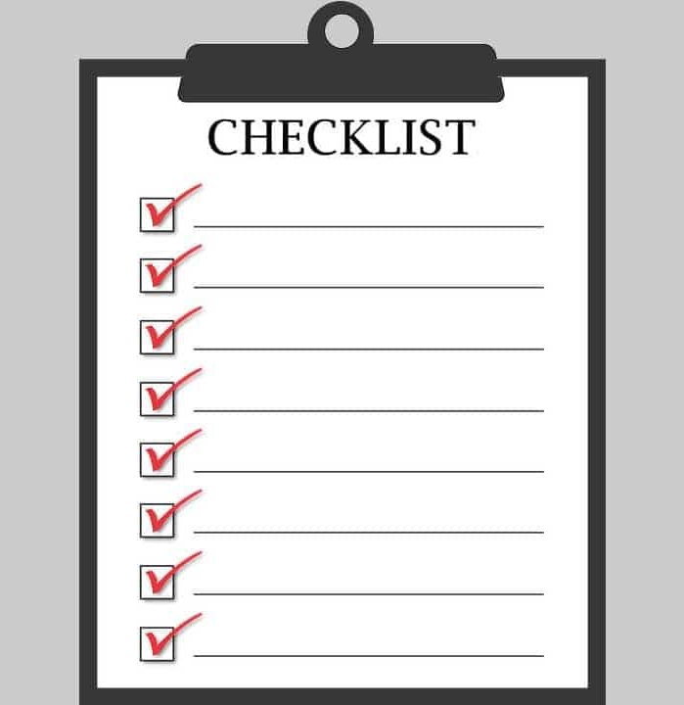
How WCAG 2.x AA can fail.
Requirements not relevant to the purpose of the website or app.
Notes:
WCAG 2.x AA provides what amounts to a long checklist of things necessary for a person with a disability to have access to all the content of a website, but most people who go to a website do not want to use all its content – they go with a purpose of some kind. Let’s see how this works:
SLIDE

Slide 22
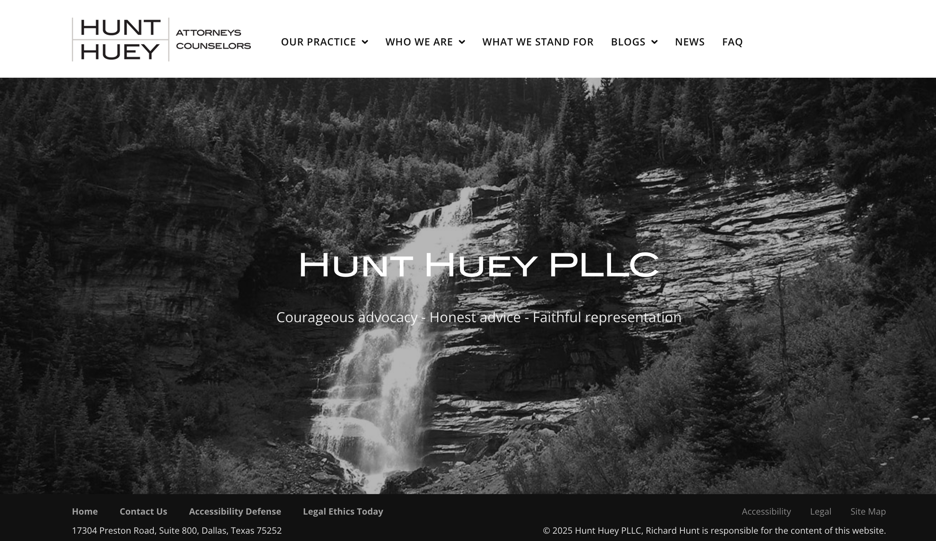
Notes:
This is the home page for my law firm. The alt text for the image reads “a waterfall in a forest.” that’s not really necessary, this is really decorative although it is a decorative image intended to convey a specific feeling. So what does success criterion 1.1.1 do with that.
But now let’s look at the various items on the front page for which WCAG 2.x AA requires accessibility.
On the lower right there is a copyright notice and a notice required by the Texas ethics rule for attoneys that says I am responsible for the website. If this were not properly coded a blind user would never know it was there, but that’s hardly likely to deny them meaningful access to the website. Unfortunately, a technical standard like WCAG 2.x AA cannot distinguish between a major fail and a minor fail – every fail is fail.
Also in the footer are links to my blog – “accessibility defense”, and my partner’s blog, “Legal Ethics Today.” These are entirely redundant because there is a menu item at the top for blogs. Nonetheless, if not properly coded these links would be WCAG 2.x AA failures.
Looking again at the footer – the place many people never go, there is a link called “Accessibility.” It takes you to a page with a nice statement to the effect we intend our law practice to be accessible with my phone number if anyone wants to discuss it. In the last eight years no one has ever called. Would it really matter to equal access if this link was not properly labeled?
There’s another link labeled “Legal.” it takes you to the terms and conditions of use for the website, which contains a lot of CYA material intended to discourage anyone, disabled or not, from suing us. Our malpractice carrier requires it but I doubt if anyone has ever clicked the link.
The point is that there is a lot of content in this website that could fail to be accessible without substantially diminishing the equal use and enjoyment of the website by a person using a screen reader or other assistive technology. There is also quite a bit of content included primarily for SEO – we never clean out our “News” section so it has news about webinars I gave years ago no one would care about today.
This is an inherent problem with any technical standard. WCAG 2.x AA can tell you how to make all the content accessible, but it can’t tell you whether any specific content matters to any specific user or even to most users. That leads to my final comment on the limitations of WCAG 2.x AA
SLIDE

Slide 23
So much code; so little time.
Notes:
I got this image from a blog at plan.io, a company that sells project management and related software. That’s plan.io – something I mention only so they won’t sue me for copyright infringement.
The problem of course is that every website owner and developer has limited resources. That leads to some practical questions.
If my website or app is not accessible how much business will I lose? It’s cold hard world in business and this is a question businesses ask. If WCAG 2.x AA conformance costs more than the likely benefit businesses may not even try.
By the way, the statistics show that web-based businesses can lose significant revenue and market share if they are not accessible. But that loss is definable in dollars and if it doesn’t exceed the cost of accessibility then accessibility is in some sense a bad investment.
If I don’t follow the law how likely is it I’ll be sued? Another cold hard question that businesses ask. Litigation costs money, but if the risk is small there may not be a good reason to invest in accessibility just to avoid a lawsuit.
A rational business will allocate development resources to the content of a website most likely to generate revenue, but WCAG 2.x AA has no criterion for revenue generation. It also has no criterion for the importance of the effect on a disabled user. I recently reviewed an expert report that defined as a critical failure the lack of alt text describing a link that was associated with an image. That alt text said something like “barbeque grills.” The presence of a link would be a pretty good clue that clicking would take you to more information about barbeque grills. Was the lack of link text critical? No. but a technical standard can’t tell that.
SLIDE

Slide 24
DOJ and the Access Board favor a technical approach
Rehabilitation Act Section 508 regulations are modeled on WCAG 2.0 AA.
ADA Title II regulations are modeled on WCAG 2.1 AA
Courts like WCAG 2.x AA because it provides (or seems to provide) an easy to apply test.
Notes:
I have proposed a lot of problems with a purely technical approach to website and app accessibility, but we can’t forget that even with the lack of Title III regulations the Department of Justice, Access Board and most courts prefer a technical approach.
Now, to keep you on the edge of your seats, I’ll tell you at the end of the 4th part of this presentation I’ll tell you how to deal with this situation in practical terms.
But we can start with a solution that does not work.
SLIDE

Slide 25
Surely Ai will save us?
Notes:
The expert report I mentioned earlier used a software solution that scans a website and delivers a report showing WCAG 2.x errors and the associated code. There are many such products on the market, and I don’t have the expertise to compare them. However, I can repeat a few things I have learned from talking to people at big consulting firms that specialize in website accessibility.

Slide 26
Some technical stuff you know better than I
Control and View - Code used: Cascading style sheets (CSS) - examples: colors used, color contest, font, and font size.
Organize and identify - Code used: HTML Elements - examples: define a form field and its label, set an image description, identify sections and headers of page, set a links name and destination.
Functions and Interactions - code used: Create functional components with code such as vue.js, react.JS, angular.JS, and HTML5- let’s call it the hard stuff the cool stuff, the stuff that makes a website useful not just informative (the first two layers make the website informative)
Notes:
I got this information about the three layers of code in a typical website from Jason Taylor, the Chief Innovation Strategist at Unsablenet – an accessibility consulting and software company. It’s from a joint presentation we made a few years ago. I’m sure it is familiar to you, but it is necessary background for discussing software solutions to accessibility.
SLIDE

Slide 27
What software solutions do
Widgets - most add a panel via an icon to control just the first layer - increase the font, change the contrast. Some claim to update code on the second layer automatically using AI.
Overlays - most add a similar panel to control the first layer plus insert code to change some of HTML elements in the second layer. This update is created normally by a QA person that updates a file renaming alt tags, labels, etc.
Notes:
This information comes again from Jason Taylor, but I will say that every accessibility consulting expert I have talked to generally agrees with this description of the available software.
Note that the two kinds of software that claim to fix inaccessible websites touch only the first two layers of code. That is a problem.
SLIDE

Slide 28
What software cannot do (I’ve heard).
Neither widgets or overlays can update the actual code in the third layer where interaction and components offer users functionality.
Sites that are informational only in nature and only use the first two layers could use a widget or overlay.
However, sites of mid-to-larger size companies have interactions such as purchase, booking, update accounts. These features to be accessible need to be manually tested and issues addressed in the third layer of code and updated by developers

Slide 29
Here’s what a lawyer knows:
FTC Order Requires Online Marketer to Pay $1 Million for Deceptive Claims that its AI Product Could Make Websites Compliant with Accessibility Guidelines
Notes:
This is the headline on a press release from the Federal Trade Commission released on January 3. The company accused of deceptive claims is Accessibe, probably the most aggressively marketed AI solution for accessibility.
Although the problem was deceptive advertising, the deceptive claim the ads made was that AI could fix inaccessible websites, and there is no reason to think any competing product is better at this than accessibe.
And there is more:
SLIDE

Slide 30
Want to get sued?
According to UsableNet, 25% (1,023) of all [website accessibility] lawsuits in 2024 explicitly cited such widgets as barriers rather than solutions. Widgets are often marketed as quick fixes for ADA compliance, but in practice, they frequently introduce new barriers while leaving underlying WCAG violations unaddressed.
Notes:
This is taken from the accessibility.works website based on statistics gathered by UsableNet, but you’ll find the same information on other websites like accessible.org, 216digital.com and
Most telling of all, the National Association for the Blind wrote, in 2021
SLIDE

Slide 31
What accessiBe says”:
4.2 Neither accessWidget nor accessFlow address or resolve certain accessibility issues, (“Excluded Issues”),
Excluded Issues:
Neither accessWidget nor accessFlow address or resolve certain accessibility issues, including (“Excluded Issues”):
accessibility issues in URL parameters (such as elements inserted in a website’s URLs to help filter and organize content or track information on the website);
accessibility remediation of documents (such as Word files), slideshows and presentations (such as ppt files), spreadsheets (such as Excel files), PDFs, audio files, video files, SVG files;
content presented in “iframe” third-party plug-ins (such as for payment processing), and other embedded formats and/or self contained content
(such as ShadowDom and ShadowRoot and Salesforce based websites);
accessibility remediation of Canvas and Flash components and elements on a Customer Website that prevent changes being made to the user-session code a Customer Website;
(e) accessibility remediation of any Non-HTML Elements, such as OpenGL XML and other;
(f) accessibility remediation of components that have been handled via Other Remediation Measures;
(g) accessibility remediation of any images or links that are subject to a Decipher Block;
(h) accessibility remediation of third-party pages included in or referred to from a Customer Website on which accessWidget has not been properly installed;
(i) remediation functionality supporting keyboard layouts other than QWERTY keyboards; and
(j) accessibility remediation made on a single-page application may not be fully effective, and it is the Customer's responsibility to verify the accessibility of such applications within the Refund Period;
(k) accessibility issues that are a result of a website being developed not in substantial conformance with industry-standard website structure conventions,
including complex menu structures or elements that override web browsers' functionalities; and
(l) , accessibility issues that are a result of websites or content management systems (CMSs) blocking or interfering with third party scripts.
Notes:
I’m sorry I couldn’t get the list of things Accessibe does not do in type large enough to be legible, but let’s just say there are a lot of them and you will find similar disclaimers for every software product that claims to improve accessibility.
There is not a single software solution that will warrant that it will make a website comply with WCAG 2.x AA if you read the fine print.
But I think we also need to hear from the people who are disabled and use the internet:
SLIDE

Slide 32
NAB Press Release – June 24, 2021
“the Board [of the National Association for the Blind] believes that accessiBe currently engages in behavior that is harmful to the advancement of blind people in society.”
Notes:
The NAB chose Accessible because it has been very aggressive in its marketing, but once again, the underlying truth is that AI can only solve some accessibility problems, and maybe not the most important ones.
SLIDE

Slide 33
So, what about software?
It is pretty good for things in the CSS and HTML layers of a website.
It might work for things in the code layer, but not reliably.
The only real solution is to manually identify accessibility problems and fix the code that causes them.
Notes:
There is, as Tom Petty observed, no easy way out. But don’t panic, what’s the worst thing that can happen? You get sued?
SLIDE

Slide 34
Website accessibility litigation

Slide 35
Website accessibility litigation isn’t going away
Seyfarth Shaw ADA Title III blog – adatitleiii.com
Notes:
This is a chart I got from Seyfarth Shaw’s ADA Title III blog. You can find similar charts elsewhere, but they all show the same trend; that is, more or less flat over a period of years. This chart only includes lawsuits filed in federal court. If you looked at lawsuits filed in state courts under state laws equivalent to the ADA you’d see there was a sharp spike upward a few years ago but things have since leveled out. That occurred because of some federal court rulings in California and New York that were not favorable to ADA plaintiffs, leading them to switch to state courts in the hope of finding a more receptive audience for their claims. But to understand this picture you need to understand the peculiarities of litigation under Title III of the ADA.
SLIDE

Slide 36
This is just another kind of serial litigation
Controlled by lawyers.
Goal is settlement at a profit to the lawyer.
Price of settlement is below likely cost of even a basic defense.
Remediation is always part of the deal.
Notes:
OK – it isn’t litigation about cereal – it is serial litigation. Website accessibility litigation is really just a new species of the same old serial ADA lawsuits.
Before 2015 most ADA lawsuits were small cases against small businesses concerning physical accessibility. A typical case involved a plaintiff who alleged that the accessible parking did not meet ADA standards, or perhaps that a bathroom failed to meet those standards.
These cases were profitable to plaintiffs’ attorneys because while the ADA does not contain any provision for damages, its technical standards are unforgiving and the right to attorneys’ fees for a prevailing plaintiff is absolute. Faced with a lawsuit over bad parking or a bad restroom a business knows that the more it defends the case the more money the plaintiffs’ attorney will win in the inevitable victory. Fixing the problem can moot the case, but most businesses had and still have multiple accessibility problems, making mootness difficult to achieve. Most important, attorneys price the cases to settle, with a settlement demand that was generally lower than the cost of asserting any defense, including a mootness defense. When settlement is cheaper than any defense it only makes sense to settle.
Compared to lawsuits about the width of parking spaces website accessibility cases cases seem exotic and the price of settlement is higher, but they are really just the same old thing – serial litigation.
NEXT SLIDE

Slide 37
Merits don’t matter
This is a point worth emphasizing. In almost every case you can settle for less than the cost of any defense that might succeed.
Lawyers who advertise all the many interesting and possibly effective defenses are looking to make money rather than solve your problem.
That’s why I’m skipping the dozen or so slides I have that describe the fascinating legal issues that surround this kind of litigation. But if you are irrationally angry and rich I want you for a client and we’ll try them all.
Notes:
I emphasize this point because there are plenty of lawyers who will take your money to put up a fight before finally admitting that it will cost a fortune to defend the lawsuit and not nearly as much to reach a settlement. If you want out, settle at the earliest possible date and pay your lawyer as little as possible. If you want to fight, my number and email are on the last slide.
SLIDE

Slide 38
Appearances are deceiving.
Title III and state law website lawsuits all look pretty much the same.
But how they are resolved depends very much on who filed the lawsuit and when.
Bottom feeders – won’t litigate, will take a thousand dollars to go away.
Mid-market – reluctant to fight, will settle in the $6,000 to $10,000 range.
No nonsense – willing to take a case to trial but will settle for less than $20,000 and more like $15,000
Notes:
Let’s start with when - Because trends in the law do not favor this kind of litigation the price of settlement is coming down. If someone tells you what they paid a couple of years ago it is almost certain the same lawyers will settle for less today.
As for the market, you can divide the lawyers who make demands and files suits into three broad categories. I can’t name names because it would hurt my clients’ ability to negotiate if I insulted any of the lawyers I have dealt with, but if to deal with this litigation you need one of the fairly small number of lawyers who do a lot of this work and can keep up with market trends. Like me, of course, and while I am the best looking, there are others who know what they are doing.
SLIDE

Slide 39
The risk to developers
In theory – a website or app developer may be a person who “operates a place of public accommodation” and is therefore liable for a Title III ADA violation. This depends on your day-to-day role in keeping the website operating.
In theory – a website developer might be considered analogous to an architect or builder responsible for an inaccessible building.
In fact – I am not aware of any lawsuits against developers based on a violation of Title III of the ADA.
But – check your contract. Website owners are increasingly including the obligation to make a website accessible in their contracts. If you fail to do what the contract requires you can be sued.
Notes:
Read the slide.
Is there anything useful to say about designing websites to avoid litigation? Well yes there is.
SLIDE

Slide 40
Plaintiffs use software tools – you can too.
Plaintiffs in ADA website cases use software tools that spot WCAG failures.
Those tools miss a lot of failures, so they are not reliable. BUT
If your website satisfies the software it may not be accessible, but it will be invisible to plaintiffs scanning the internet using software tools.

Slide 41
A plan of action
Check the website using good quality software tools and fix whatever problems it finds. Include things that aren’t really problems – your goal is to be invisible, not to be right.
Check the website with human users who can find the problems software cannot find and fix those to make the website genuinely accessible.
Notes:
DON”T FORGET STEP 2. Remember that inaccessible web sites lose money for the owner. Also, there are users that are not in the litigation business and might really try to buy something, fail and get mad enough to sue. It doesn’t happen often, but it does happen.
And, by the way, it is the right thing to do, law or no law.
SLIDE

Slide 42
Let’s wrap this up
Notes:
Now for the wrapup.
SLIDE

Slide 43
At least one website accessibility law applies to almost any kind of business, non-profit or government agency. These laws are inescapable.

Slide 44
Whether ADA Title III covers online only businesses is uncertain, but your client can be sued in a court that says it does cover their business, so there is no comfort in the controversy.

Slide 45
Title III of the ADA does not have a regulatory definition of “accessible” but WCAG 2.x at success level AA is what DOJ, plaintiffs and the Courts are looking for.

Slide 46
There is no software or AI solution for accessibility – all such solutions have serious limitations.

Slide 47
ADA website litigation isn’t going away but, Developers are very unlikely to be sued by anyone other than their own customers.

Slide 48
Where to find me
Richard M. Hunt
rhunt@hunthuey.com
214-641-9182
hunthuey.com
accessdefense.com
Notes:
I would like to especially encourage you to subscribe to my blog at accessdefense.com. I’m behind on blogging because I agreed to do too many presentations in too short a time, but in general I post every week with either a summary of every ADA and FHA decision in the past few weeks or a longer look at a single case that raises and interesting issue. At one time I had several thousand subscribers, but then I deleted the Russian bots and it went down to a more plausible number. In any case, I think you’ll find it reasonably interesting and not time consuming to read.
Thanks etc.

