Slide 1
Thinking Beyond WCAG and Compliance
DIGITAL ACCESSIBILITY
Notes:
Good morning everyone, thank you for joining! I’m excited to be talking with you about thinking beyond WCAG and compliance in digital accessibility

Slide 2
Who Am I?
Who Am I?
Chris Scholtens, CPACC
he/him/his
I am a Director of Product Management at Enghouse Video, and the resident accessibility champion. I help make sure digital products are not just checking an accessibility box, but that we are making a commitment to inclusion, equity, and empowerment. I started my career in UX design and research, before moving over to product management, but I have always had a passion for accessibility.
Notes:
My name is Chris Scholtens, and I am a Director of Product Management at Enghouse Video; my background is in UX design and research, and I have always had a passion for accessibility.

Slide 3
HOW TO BEGIN: What are some practical steps for getting started?
OVERVIEW
FOUNDATIONS: We can’t look beyond standards and compliance without meeting them first
PERFORMATIVE ACCESSIBILITY: Are we prioritizing appearances over meaningful user benefits?
BROADER IMPACT: Making accessible products should be seen as a driver for innovation and positive culture
BEYOND COMPLIANCE: What are some practical examples of looking beyond WCAG criteria?
Notes:
Why are we here today? Over 96% of the world’s top one million web pages are not accessible, meaning we have a lot of work to do to help users access the products, services, and content they need to navigate their lives. Today we will start by looking at the foundations; we can’t go beyond standards and compliance without understanding and meeting them first. Then we will look beyond compliance, at some practical examples of going beyond the WCAG criteria. We will also talk about performative accessibility and what that means. Next we will talk about accessibility’s broader impact on organizations and companies, and finally, we will talk about how to begin.

Slide 4
The one argument for accessibility that doesn’t get made nearly often enough is how extraordinarily better it makes some people’s lives. How many opportunities do we have to dramatically improve people’s lives just by doing our job a little better?
“
FOUNDATIONS
“
STEVE KRUG
Notes:
So what are the foundations of making accessible products and services? Why do we do it, and why do we care? *read quote*

Slide 5
The World Health Organization estimates that 1.3 billion people experience significant disability, or about 1 in 6 people
DISABILITY IMPACTS ALL OF US
Cognitive Disabilities
Visual Disabilities
Intellectual
Dyslexia
Dysgraphia
Math and computation
Attention Deficit Hyperactivity Disorder (ADHD)
Autism Spectrum Disorder (ASD)
Non-verbal Learning Disability
13.9% of people have cognitive disabilities
Blindness
Color blindness
Low vision
5.5% have visual disabilities
Speech Disabilities
Articulation
Aphasia
No speech
5% have speech disabilities
Mobility Disabilities
Manual dexterity / fine motor control
Ambulation
Muscle fatigue
Body size or shape
12.2% have mobility disabilities
Psychological Disabilities
Social
Emotional
Behavioral
23.1% have psychological disabilities
Auditory Disabilities
Deafness
Hard of hearing
Central auditory processing disorder
6.2% have auditory disabilities
Notes:
Disability impacts all of us; The World Health Organization estimates that 1.3 billion people experience significant disability, or about 1 in 6 people. The categories of disabilities on screen right now, like cognitive, mobility, auditor, visual, speech, and psychological disabilities are not an exhaustive list.

Slide 6
WCAG
FOUNDATIONS: LEGAL STANDARDS
Despite different regulations in different countries and regions around the world, almost all accessibility law points back to the WCAG standards
European Union (EN 301 549, European Accessibility Act)
United States (ADA, Section 504/508, Title II updates)
v
United Kingdom (Equality Act of 2010)
Canada (Accessible Canada Act, AODA)
Japan (JIS X8341-3)
Australia (Disability Discrimination Act of 1992)
India (Rights of Persons with Disabilities Act)
Israel (Equal rights for people with disabilities act of 2013)
Notes:
Because disability impacts all of us, many countries and regions around the world have created legal standards for making various products and services accessible to all users. But all of these legal requirements point back to a version of the WCAG standards, meaning we can focus our efforts there. As a side note, I will be saying WCAG today. I know there are differing ways people pronounce the acronym W C A G.

Slide 7
WCAG 2.1 was published in 2018
WEB CONTENT ACCESSIBILITY GUIDELINES (WCAG): WHY
Written and published by the World Wide Web Consortium (W3C)
WCAG provides a single shared standard for web content accessibility that meets the needs of individuals, organizations, and governments internationally
WCAG 2.0 was published in 2008
Digital content and experiences should conform to the guidelines
There are 13 guidelines, organized under four principles: perceivable, operable, understandable, and robust
For each guideline there are testable success criteria; the criteria are further divided into A, AA, and AAA levels
WCAG 2.2 was published in 2023 – We are here!
There have been three major versions of WCAG 2:
Notes:
So why WCAG? For many of you, this may be a review of information you already know. The WWW consortium created a single shared standard for individuals, organizations, and governments, with testable success criteria divided into 13 guidelines, and four organizing principles: perceivable, operable, understandable, and robust. The standards have also been updated over time, allowing the standards to ensure that digital content is accessible to all users.

Slide 8
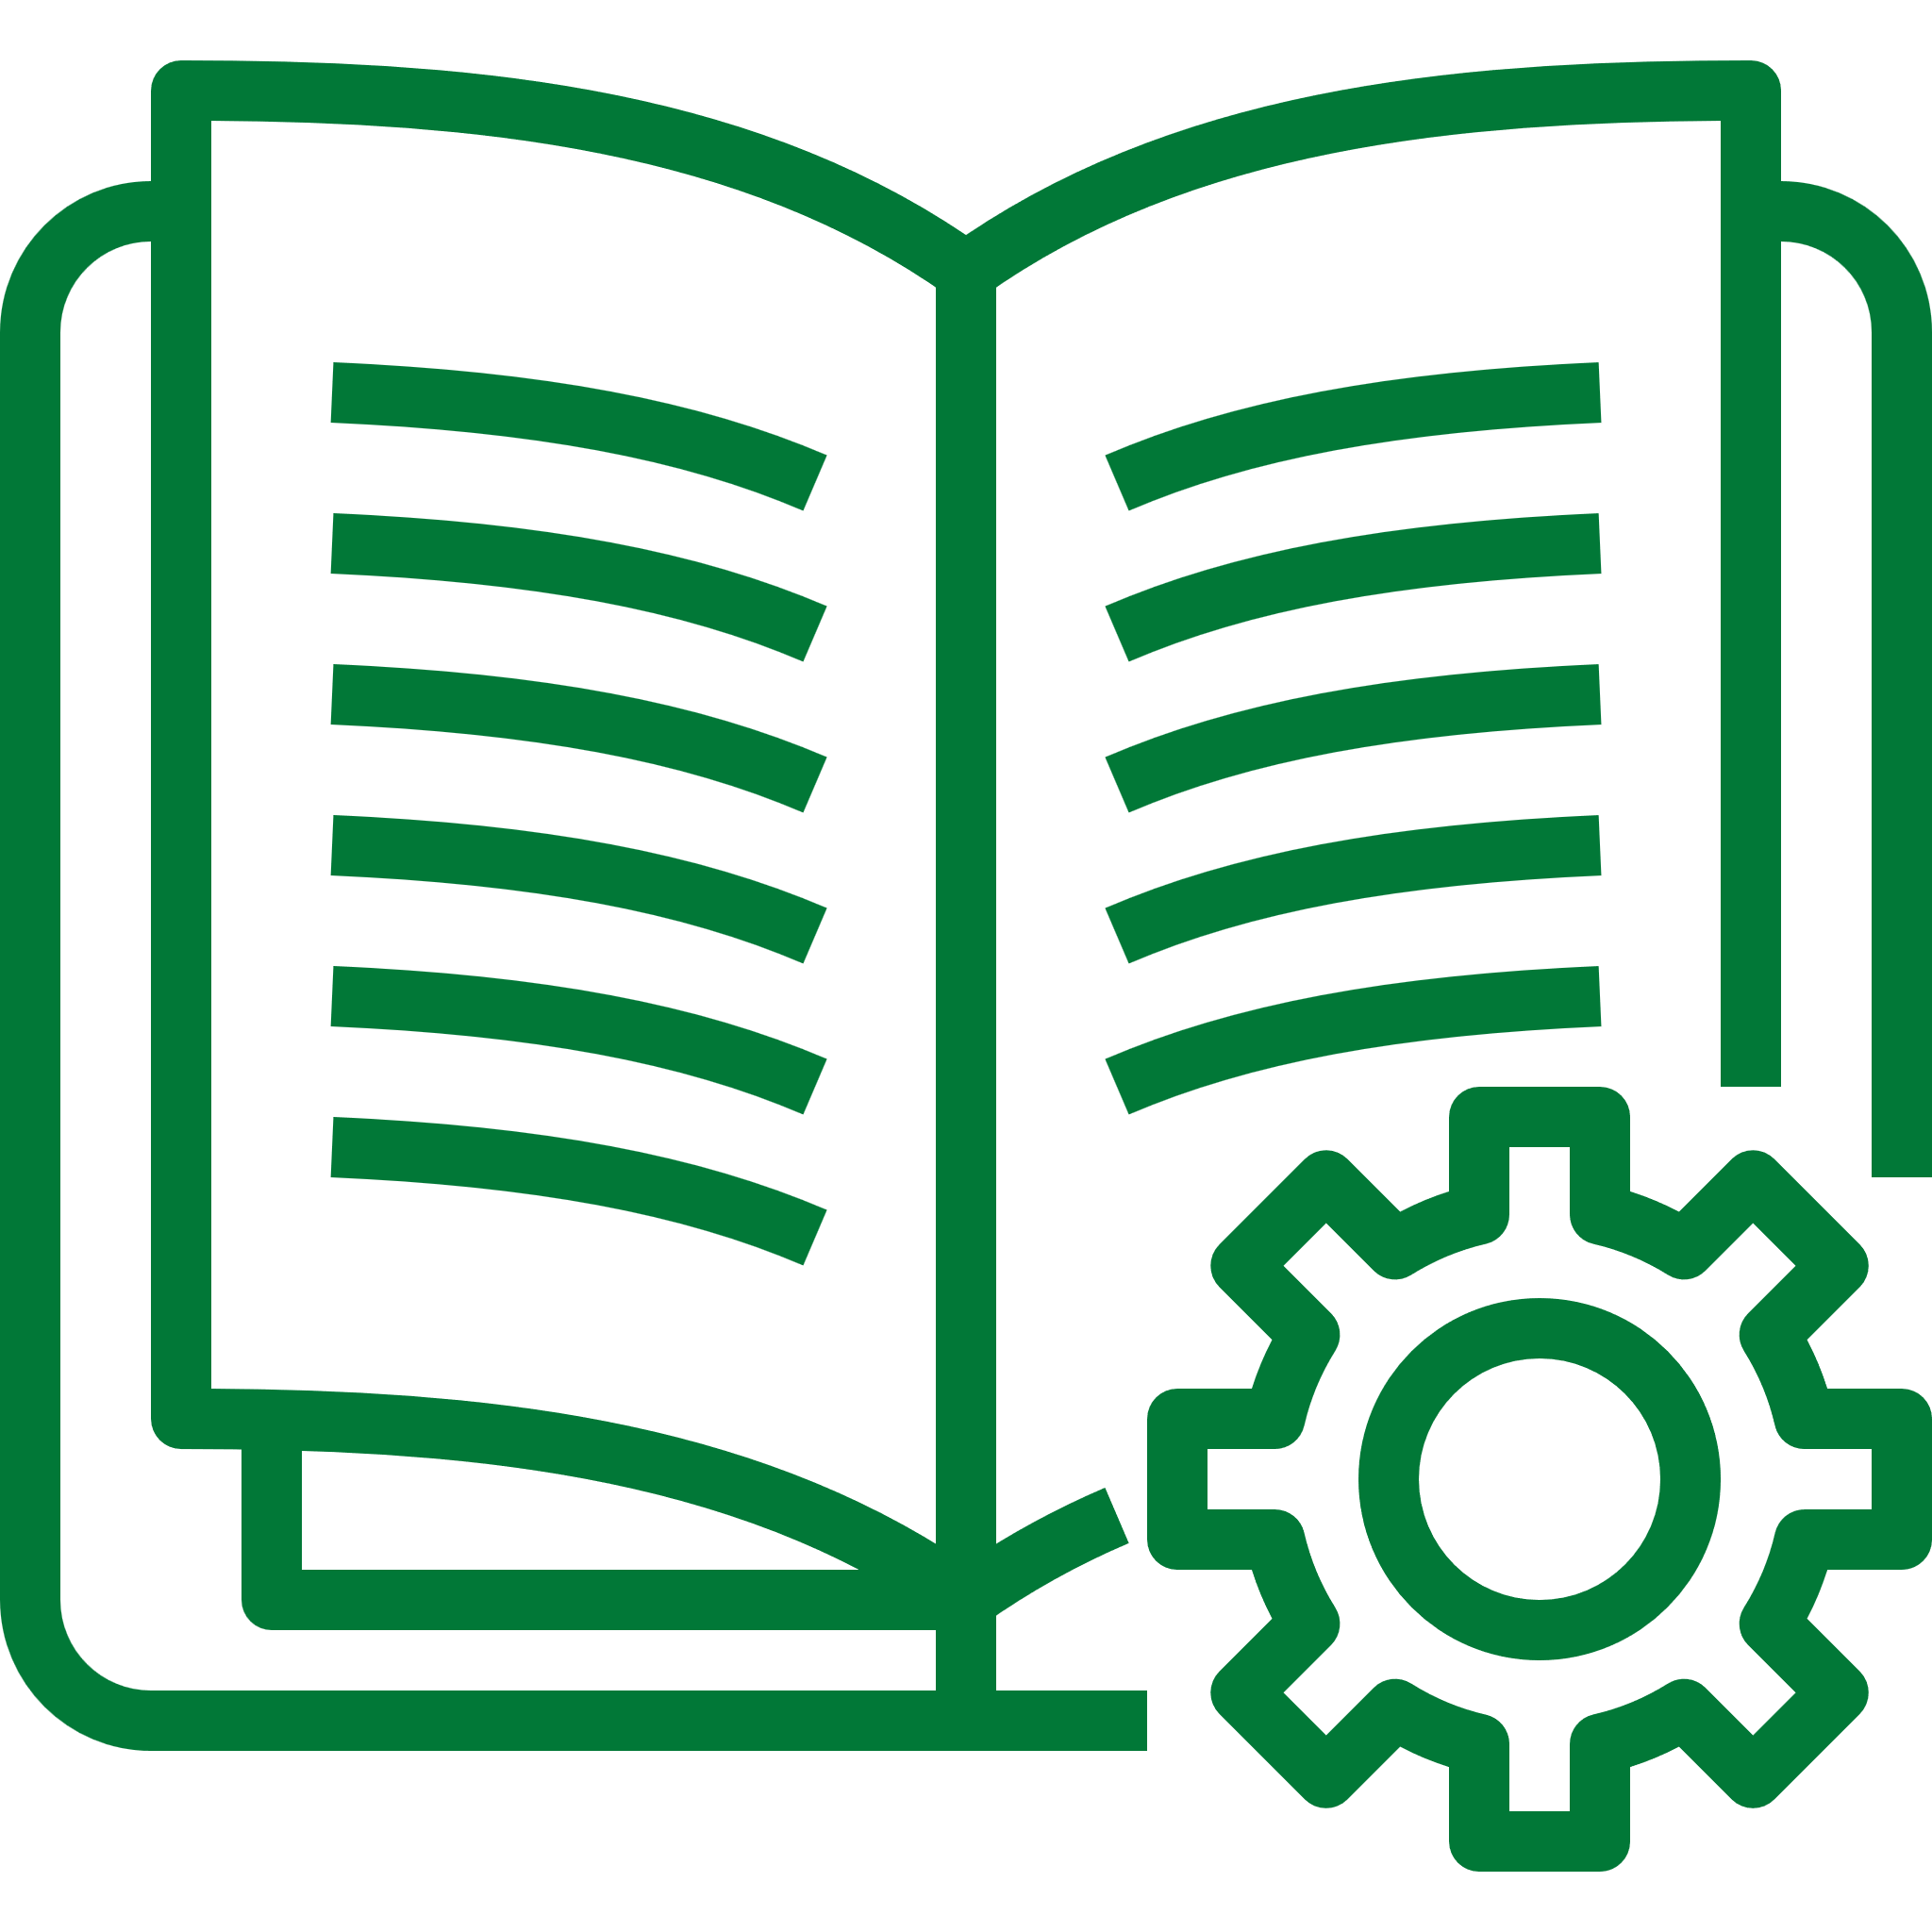
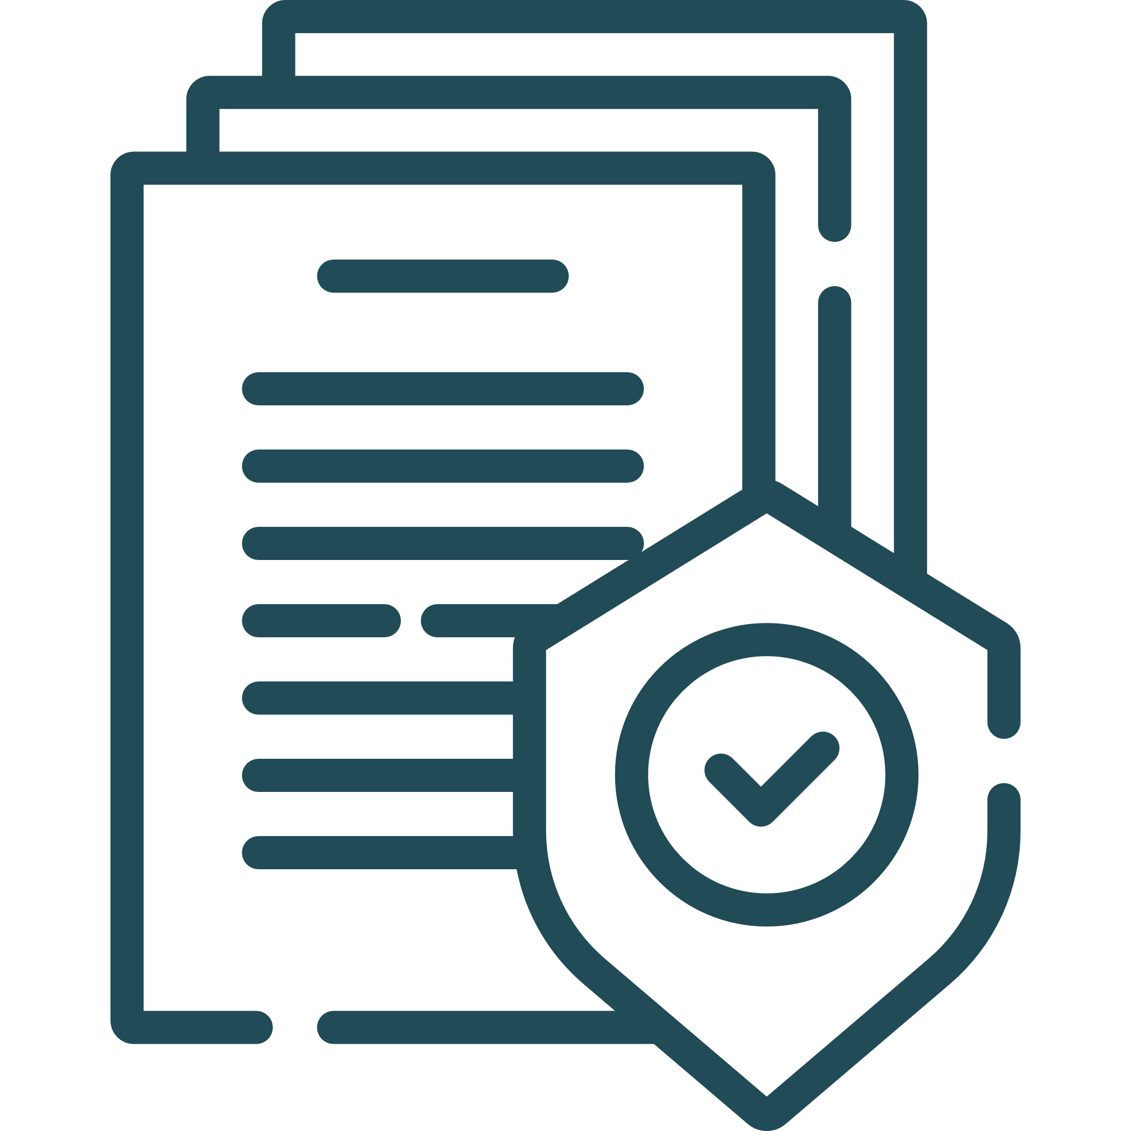
WEB CONTENT ACCESSIBILITY GUIDELINES (WCAG): WHY NOT
The guidelines are an important baseline, not an end result
Being focused on a compliance only mindset limits how you can help users
Notes:
But why isn’t WCAG our end goal? The guidelines are an important baseline, but just meeting them doesn’t ensure the most accessible experience for your users. In fact, being solely focused on compliance can limit how much you can help users access your product or service!

Slide 9
BEYOND COMPLIANCE
“
“
Exceeding expectations is where satisfaction ends and loyalty begins.
RON KAUFMAN
Notes:
So how do we look beyond compliance? As Ron Kaufman says *read quote*

Slide 10
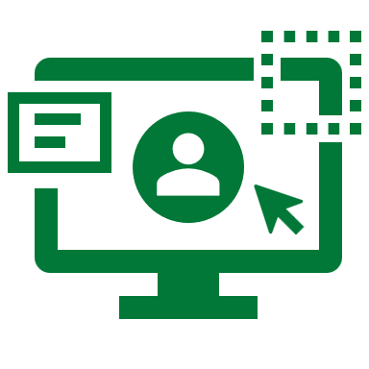
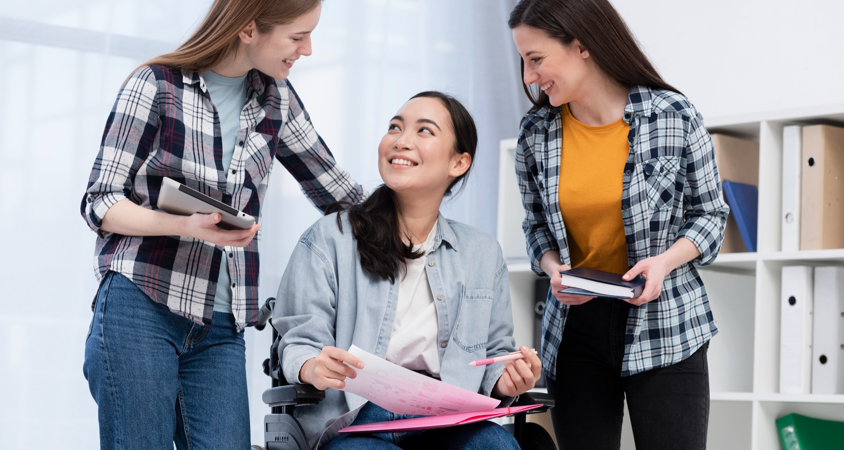
WHERE WE FALL SHORT
We focus on meeting the standards as an end goal; accessibility has been achieved
WCAG is a good baseline, but all too often conversations about accessibility, design, and development are too simplistic
Accessibility is a checkbox that we have to check
Making a product accessible takes more time and money
Focus is put on alt tags for images, color contrasts, and maybe Aria elements
The WCAG principles (perceivable, operable, understandable, and robust) don’t always get equal attention
Users with different disabilities don’t always get equal attention
Notes:
In the many conversations I have had about accessibility over the years, we often fall short when talking about accessibility, accessible design, and developing with accessibility in mind.
All too often, accessibility is a checkbox; did we hit the standards? Fly the mission accomplished banner! Or we only care so that we can meet a requirement on an RFP for sales, our product is “accessible”.
Or I hear the common refrain, accessibility takes more time and more money (more on that later!)
Or maybe we have well intentioned developers, and they are thinking about accessibility, so they make sure their images have alt tags, they check color contrast ratios, and even use some aria elements!
Maybe an organization actually cares about the WCAG standards, but too often they focus on making their product or service perceivable and operable, but not on making sure it is understandable or robust.
And certainly, users with different disabilities don’t always get the same attention. Someone with ADHD may have a harder time understanding long form content. Someone with dyslexia may have a harder time perceiving text based content
The single best thing you can do is DO REAL WORLD TESTING WITH USERS WITH DISABILITIES

Slide 11
INVEST IN NOVEL WAYS TO IMPROVE ACCESSIBILITY
How can you focus on difficulties users with different disabilities may face?
How can you make your digital content more perceivable, operable, understandable, and/or robust?
Notes:
So WCAG isn’t our end goal. What do we do? Invest in novel ways to improve accessibility. Focus on the difficulties users with various disabilities may face (these can be unearthed during your real world testing!)
Think about how you can make your digital content more perceivable, operable, understandable AND more robust.

Slide 12
PRACTICAL EXAMPLES
How have you made your product more accessible to your users in novel ways?
What useful ways have you seen a product be accessible to its users?
Notes:
So what are some practical examples? I’d love to see in chat, how have you made your product or service more accessible? Or how have you seen another product or service be more accessible to its users?
Let’s take a look at some other examples.

Slide 13
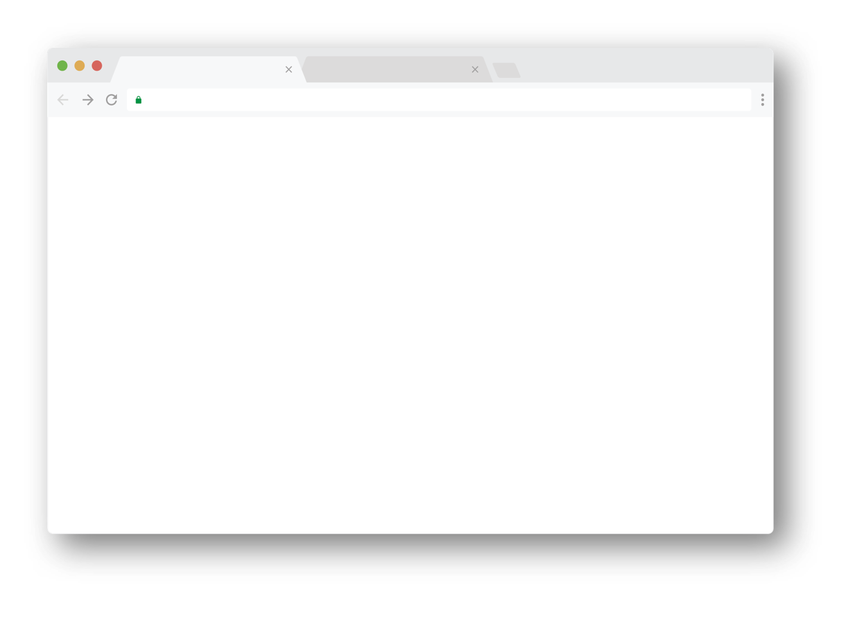
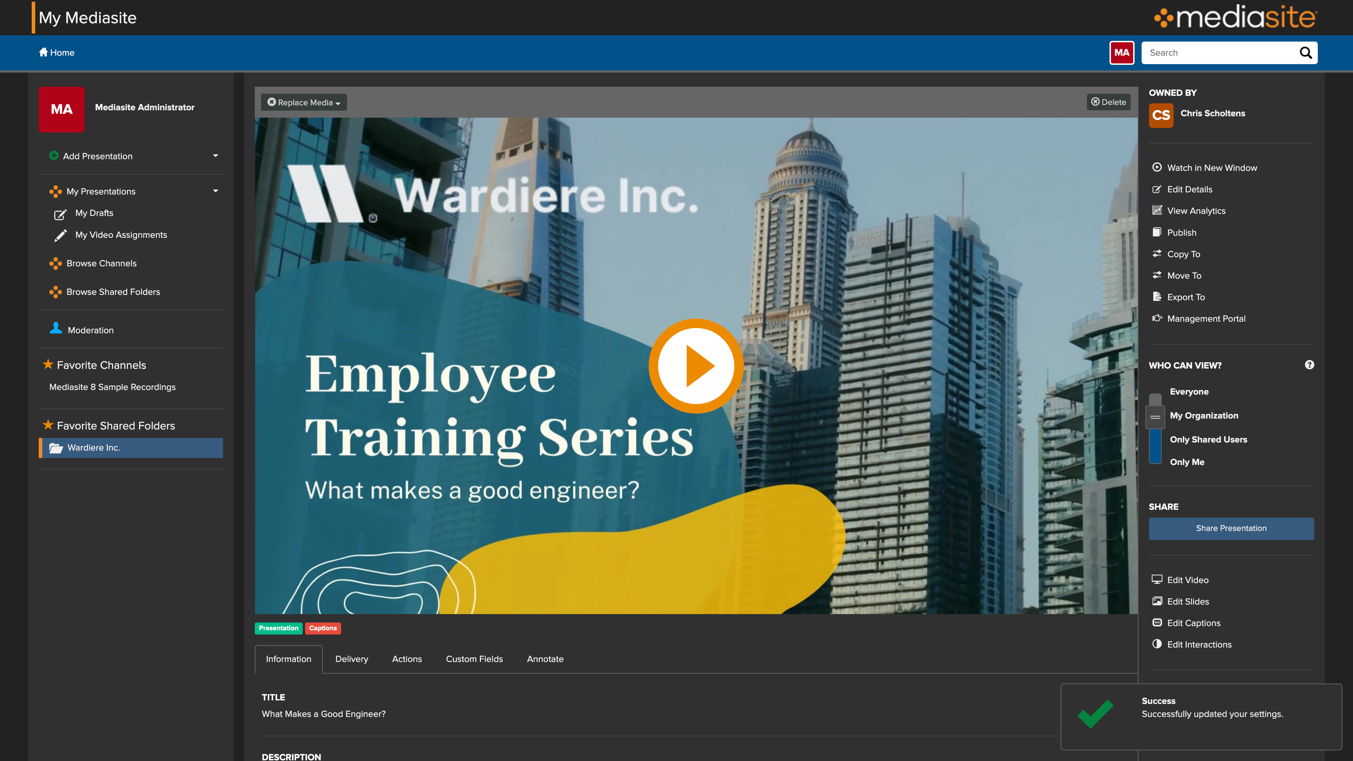
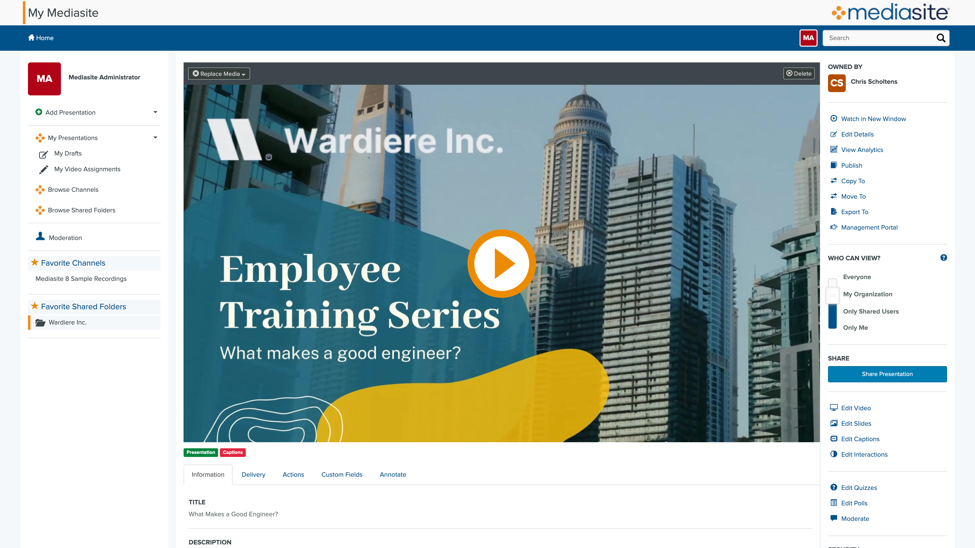
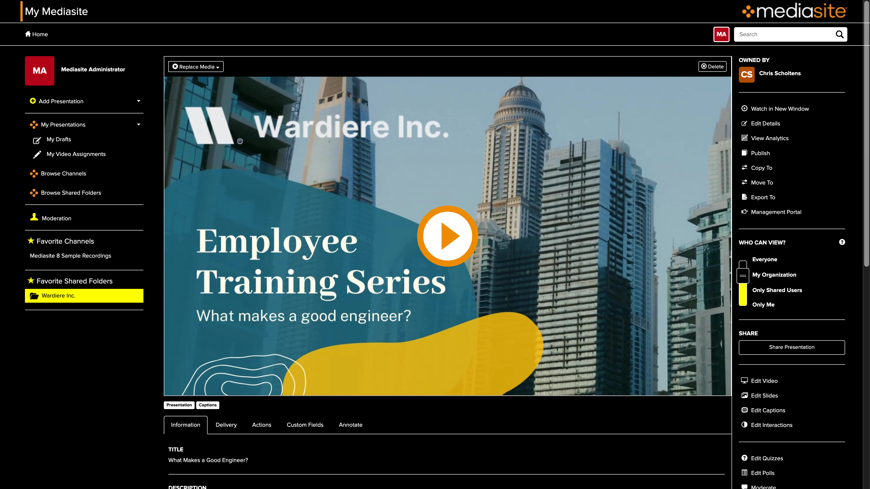
THEMES
DARK THEME
HIGH CONTRAST THEME
LIGHT THEME
Allowing users to select a light theme, a dark theme, or a high contrast theme improves usability by matching a user’s experience with preference. There’s a myth that dark mode is good for accessibility, because it improves text readability (among other things). Offering a separate, distinct high contrast theme is a way to improve accessibility, with the highest possible contrast ratios. This benefits users with visual disabilities.
Notes:
One common way I see of making a product more accessible is by introducing themes. Light and dark modes are becoming common, with high contrast somewhat less common. This allows users to select their preference, which improves accessibility and usability.
I will note, I keep hearing this myth that dark mode is inherently good for accessibility because it improves text readability. That is not always true, and why I recommend a true high contrast theme as well.

Slide 14
DYSLEXIA FRIENDLY FONT OPTIONS
Dyslexia Friendly Font Options
There are multiple font options designed at improving the reading for individuals with Dyslexia, focusing on the specific challenges they face.
Letters have heavy weighted bottoms to indicate direction. Users can to quickly figure out which part of the letter is the bottom, which aids in recognizing the correct letter.
Dyslexie and OpenDyslexic are two well known examples. Research about the effectiveness of these types of fonts is inconclusive, with user preference playing the greatest factor.
Notes:
Dyslexia friendly font options;
There are fonts, like Dyslexie or OpenDyslexic, that are designed to be more readable for individuals with dyslexia. The research about the effectiveness of these fonts is mixed, and color can play an important factor as well. But again, offering users choice will improve accessibility for an individual.

Slide 15
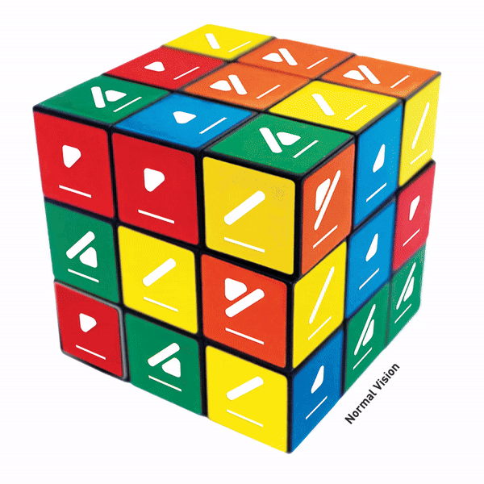
COLORADD LANGUAGE
ColorADD Language
ColorADD® is a unique, universal, inclusive, and non-discriminative language that enables the color blind to identify colors, whenever color is a factor of identification, orientation, or choice.
The website Boardgame Arena has implemented ColorADD in some of its games, alongside real world counterparts, such as Uno or Rubik’s Cube for color blind and other visually disabled users.
Notes:
ColorADD language is a language of symbols identifying colors, to allow individuals with visual disabilities to identify and engage with items where color carries informational significance. Both in the digital and real world, products like the Rubiks cube and services like subway maps are adopting this language to offer an alternative means of conveying the information.

Slide 16
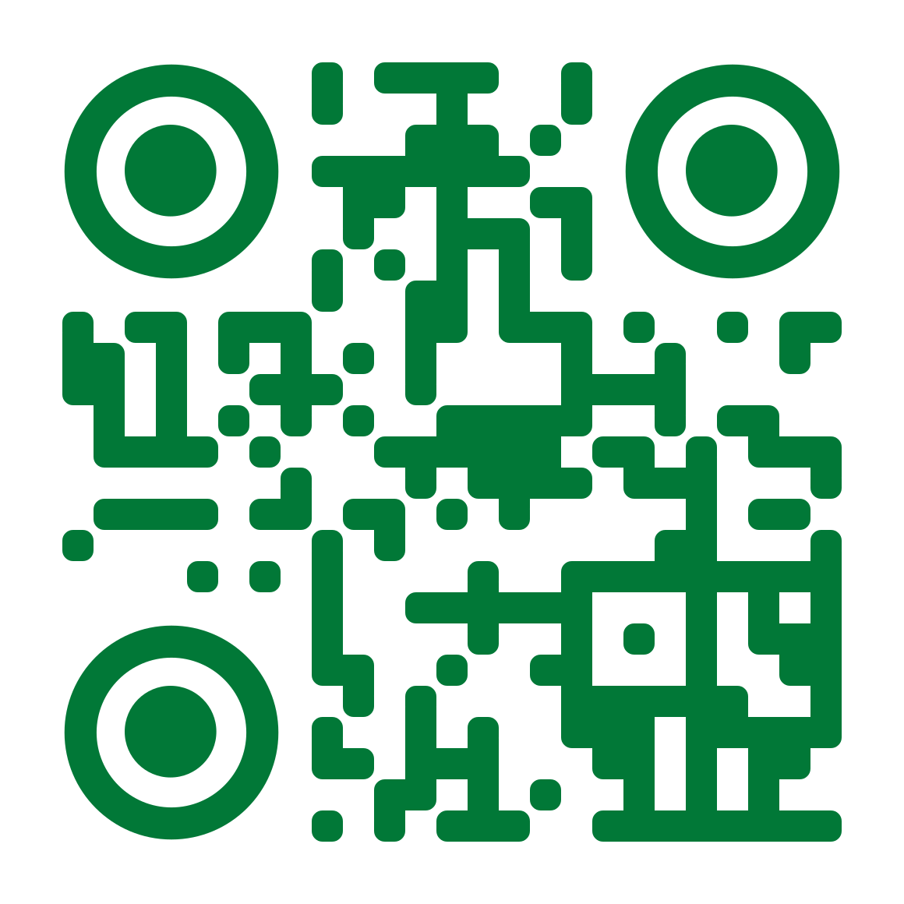
QR CODES
When used properly, QR codes can improve accessibility. Many people with disabilities have difficulty entering long addresses into their mobile web browsers, and for those consumers, scanning a QR code saves quite a bit of time.
However, QR codes can present challenges for other users. People with vision disabilities may have trouble lining up the QR codes with their cameras — and if the code redirects the user to an inaccessible website or mobile app, the experience can be frustrating. Offering QR codes as an option, not the option provides a more flexible, accessible solution to users.
https://www.w3.org/TR/WCAG22/
Notes:
A while ago, someone mentioned to me that QR codes improve accessibility. I had never thought of them in the context of accessibility, but when I did, I realized, yes, QR codes CAN improve accessibility. If a user has a hard time entering in a long web address, scanning a QR code can save time or even make a task possible
But QR codes can also present challenges for users with visual or motor disabilities. Offering QR codes as AN option, not the only way provides a more flexible and accessible solution.

Slide 17
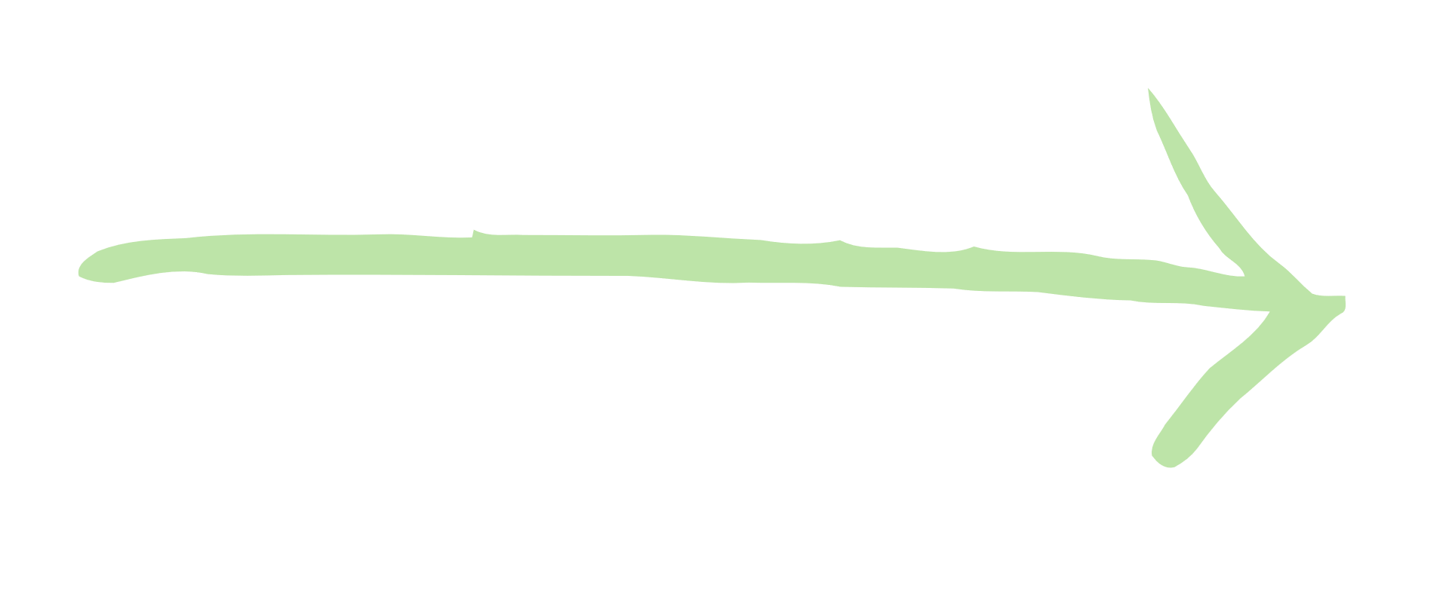
TRANSLATION
Offering a product or service in more than one language improves usability and accessibility. Users prefer to view content in a language they are comfortable with. By offering choice, their experience is improved.
Notes:
I don’t often hear translation brought up in the context of accessibility, but offering content in a users’ preferred or native language DOES improve usability and accessibility.

Slide 18
PERFORMATIVE ACCESSIBILITY
“
“
I try to keep in my mind the simple question: Am I trying to do good or make myself look good?
KEVIN DEYOUNG
Notes:
So we should all rush out and implement all the ideas presented today, and everything else we can come up with, right? Well, let’s talk about performative accessibility. *read quote*

Slide 19
WHAT IS PERFORMATIVE ACCESSIBILITY?
What is performative accessibility?
Actions that prioritize appearances or “optics” over any meaningful benefit to the user are performative. Are you adding a capability to your product to help your users, or so that you can write a nice article for LinkedIn to pat yourself on the back? Are you hiding behind self inflated achievements, or is your foundation secure?
It can be difficult to walk the tightrope between offering a new way to make a product accessible to more users, and doing something for the accolades. Remember, for both the user and for the business, it’s better when things are genuinely more accessible.
Notes:
What is performative accessibility? It boils down to doing something for how it looks. Did you add a feature to improve accessibility because it helps users, or because it make you look good, and you can pat yourself on the back on LinkedIn? This gets back to making sure your foundation is secure first, and THEN building from there.
I will be the first to admit that it can be a tightrope walk. There is a reason I mentioned the downsides of the previous practical examples. But ultimately, for both the user AND the organization, it’s better when things are more accessible.

Slide 20
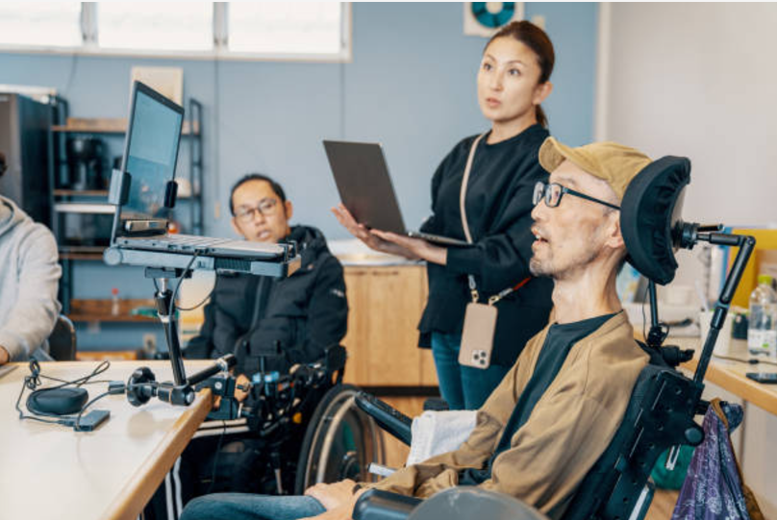
DOING IT RIGHT
Listen to your users! Find out their needs, find out their pain points. Involve them in design and in testing. There is no substitute for real users with disabilities testing a product.
When you can make it happen (finding time, budget, resources, and leadership buy in), have your product audited by a third party. This gives legitimacy to your foundational compliance claims, and reassures that you are ready to be investing in novel ways of making your product more accessible.
Notes:
So what does doing it right look like?
LISTEN TO YOUR USERS, TEST WITH REAL USERS WITH DISABILITIES. There is no substitute.
Make sure your foundation is secure. When you can make it happen (which can be hard to find time, budget, resources, get buy in from leadership, etc.) have your product audited for accessibility compliance by an independent third party. That gives legitimacy to your foundational claims, and lets you know you are ready to invest in novel solutions.

Slide 21
BROADER IMPACT
“
“
Everything you do has some effect, some impact
DALAI LAMA XIV
Notes:
At this point, I hope you are bought in to going beyond WCAG. If you are at a WordPress meetup on accessibility, you probably didn’t need much convincing, this is better for users. But what about the broader picture? What does this mean for your organization? As the Daleye Llama said, *read quote*

Slide 22
The broader picture
THE BROADER PICTURE
Hopefully it is clear why investing in novel solutions for accessibility benefit users. But what benefit does it bring to the organization? Building or developing accessible products costs more money and time, right?
Notes:
Everyone knows, building and developing accessible products only costs more money and time, right?

Slide 23
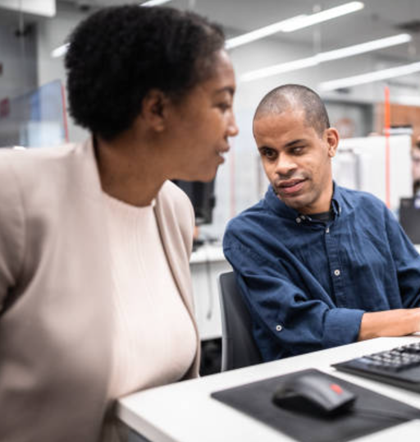
POSITIVE BENEFIT TO ORGANIZATIONS
Rather than merely aiming to avoid negative consequences, like being sued for non-compliance, improving accessibility actually brings positive benefits to organizations. In reality, accessibility can be a driver for innovation, fosters brand loyalty, increases market reach, and creates a culture of empathy.
In the digital world, captions on videos have become commonplace, but they started as a capability to allow TV viewers with auditory disabilities to watch TV.
Accessibility design and development is not a time and money sink, it improves products and the organizations who make them.
Notes:
In my earliest days of fighting for accessibility, I often got buy in solely to avoid negative consequences (we don’t want to get sued or maybe we just need it to win a customer deal). When I tried to request time, budget, staff, or other resources to improve accessibility beyond that, it was an uphill battle.
In reality, building and developing accessible products and services has a positive benefit to organizations. It drives innovation, increases market reach, can foster brand loyalty, and can create a culture of empathy. These are the arguments that can help make your case when requesting resources to do more. (But if you can only get buy in to improve accessibility to avoid a negative consequence, take it! It is better than not being given anything to improve accessibility)
As an example, of accessibility driving innovation, look at closed captions. They started as a capability for TV viewers with auditory disabilities to watch TV, but have been widely adopted. Even our meetup today is being live captioned. I can’t remember the last time I watched a TV show without the captions on!
Or take a look at late night TV. Many of the products you see in infomercials came to life as an accessible alternative. Think about the Snuggie. A blanket with sleeves? It was designed for wheelchair users. But they have become popular with the market in general.
Accessibility design and development is not a time and money sink. It truly improves the products AND the organizations who make them.

Slide 24
HOW TO BEGIN
Even the greatest was once a beginner. Don't be afraid to take that first step
MUHAMMAD ALI
Notes:
So now we all are bought in, and we have convinced our leadership to buy in to improving accessibility beyond just meeting the standards. So where do we begin? The great Muhammad Ali said *read quote*

Slide 25
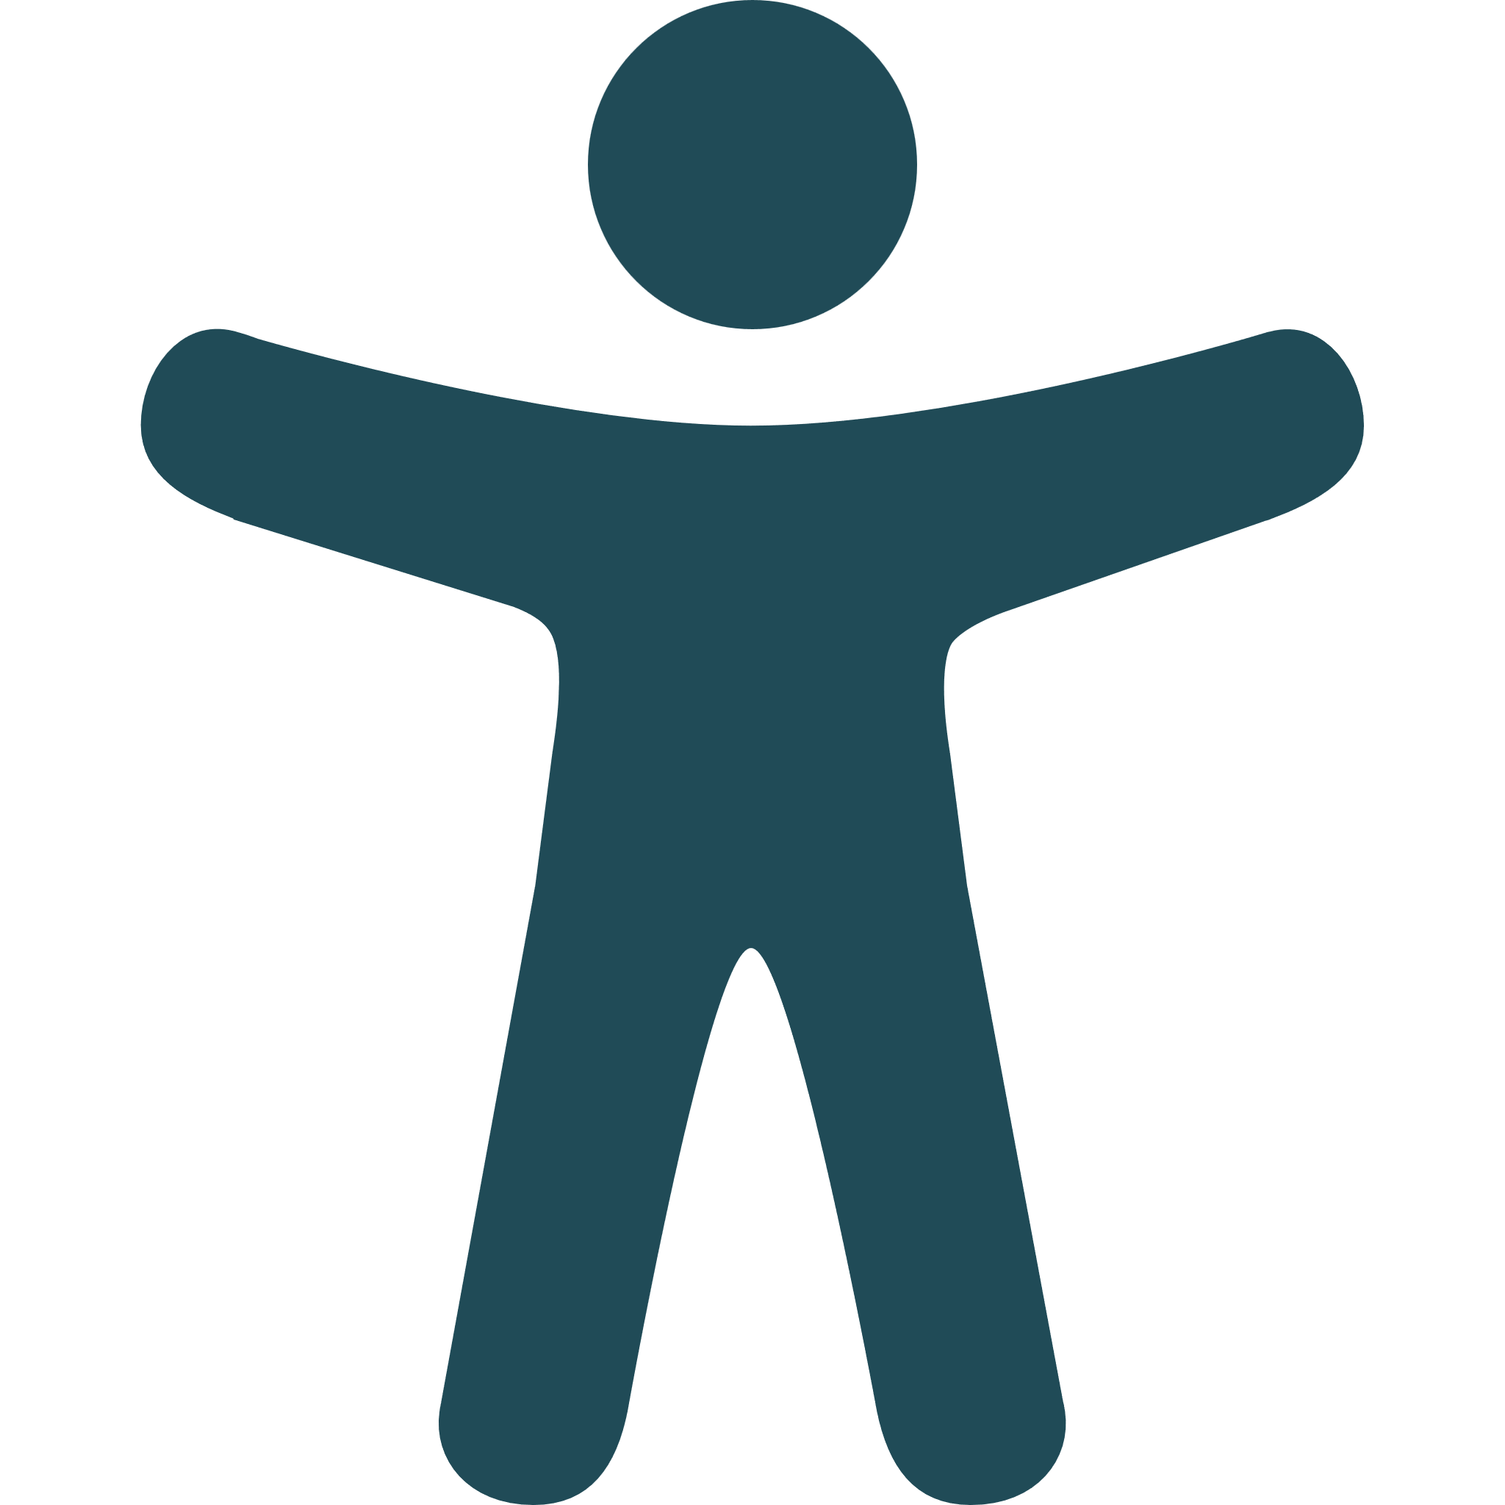
AVOID COMMON MISTAKES
Like the old joke says, how do you eat an elephant? One bite at a time.
You have to start, but realize that no product is ever perfectly accessible to all users. Make improvements where you can, putting in the work of designing, developing, and testing every step of the way.
There is no Magic Solution
Going it Alone will Lead to Burnout
Perfect is the Enemy of Good
Accessibility is a Program not a Project
Notes:
Like the old joke says, how do you eat an elephant? One bite at a time. You just have to start. The same is true for accessibility. Hopefully I can help you avoid some common mistakes along the way!
No product is ever perfectly accessible, so make small improvements over time. Don’t wait for your product to be perfect.
There is no magic solution, because accessibility is a program of improvement, not a project with a finish line.
And last, but certainly not least, you can’t do all this on your own. Whether you have a team, co-workers, or even a cohort like the people on meetup, someone can help you. Going alone will lead to burnout.

Slide 26
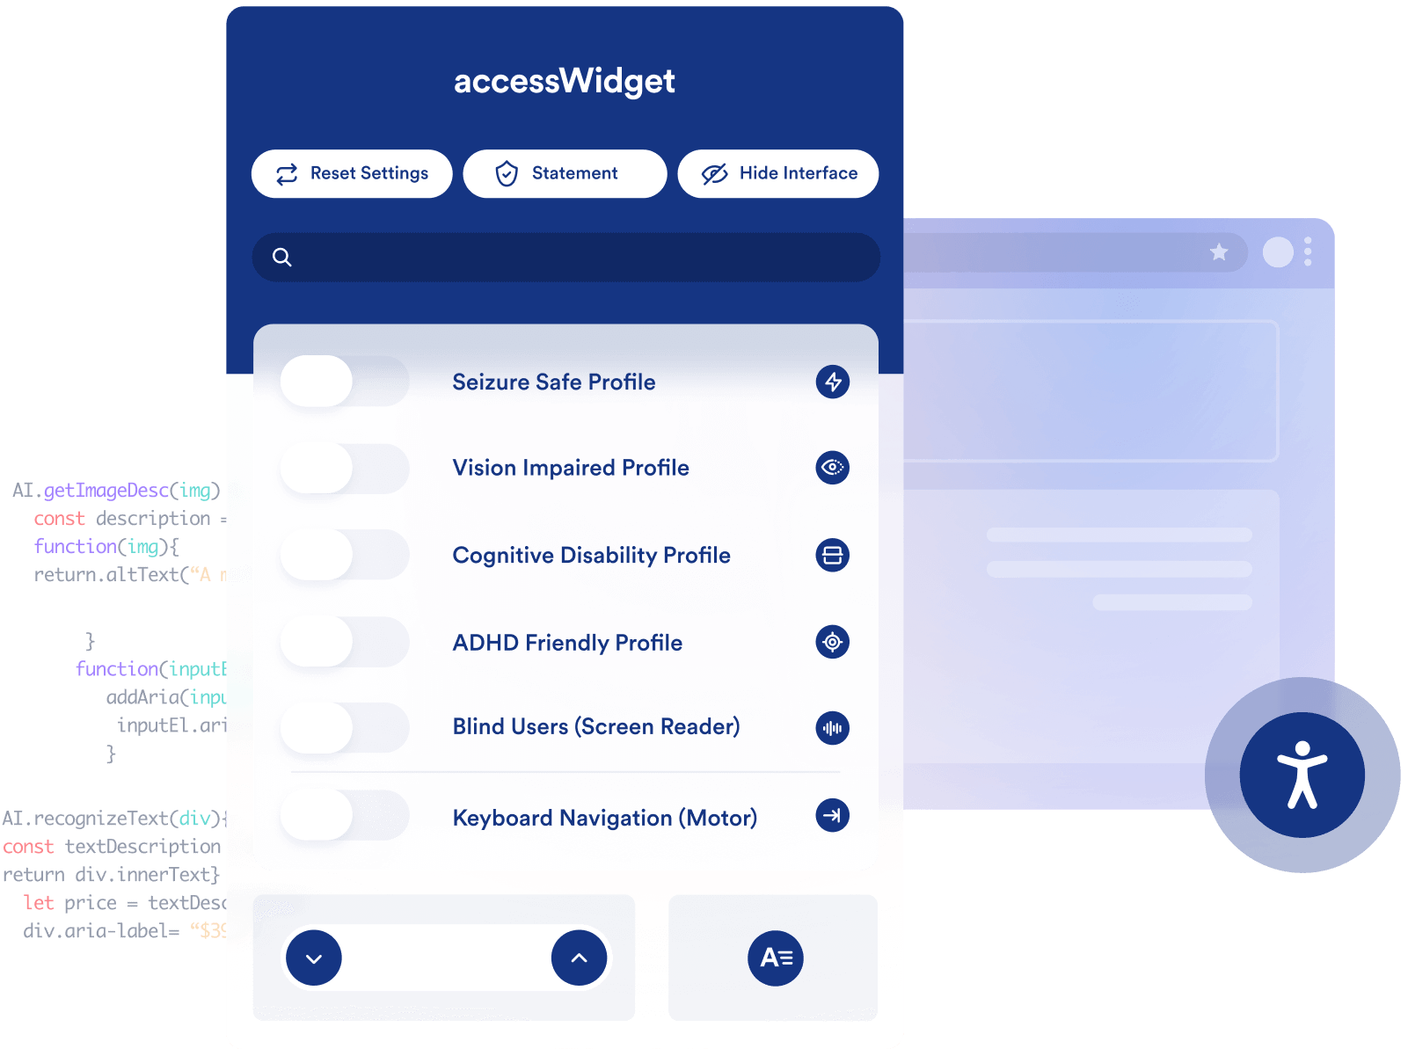
START WITH OTHERS
Take advantage of an existing plugin or library?
Come up with something cutting edge? Verify and test your idea with actual users.
Notes:
Start with others. Can you take advantage of a plugin or a library (for WordPress or outside it) that will help improve your accessibility? I will add the caveat, not all plugins are created equal, so do your research.
Make sure your foundation is rock solid. Use automated testing to identify potential issues. Get an audit done.
Existing digital footprints can be made up of hundreds, even thousands, of websites, and potentially millions of web pages. This is why audits use a representative sample. It’s impossible to test every single page. It’s just not necessary. It’s also why it’s important to build websites on a stable foundation. Make your templates and design systems accessible. They make creating and auditing content much easier.
Listen to your users. They know when they find something frustrating or unusable.
Test with real users with disabilities. I may sound like a broken record, but this is the most important thing you can do. As a side note, what is a good aphorism that modernizes broken record? I am just now thinking about this.
If and when you do come up with novel solutions, verify and test with your users. Then, come and tell me, so I can learn too!

Slide 27
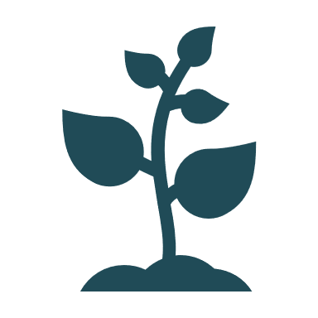
ACCESSIBILITY IS A JOURNEY
Challenge yourself, what more can we do to serve our users? Embrace the spirit of continual improvement.
Remember, true accessibility starts with empathy and grows through innovation, shaping products that genuinely enhance the lives of those we serve.
Notes:
I want to leave you with this thought. Accessibility is a journey. We have to embrace the spirit of continual improvement, challenging ourselves to do more to serve our users’ needs. We have to start with empathy and grow through innovation, so that we can shape products that genuinely enhance the lives of those we serve.

Slide 28
QUESTIONS?
Questions
Notes:
At this point, I am happy to open up for questions.

